Slide 1
Eric Berne Archives
www.ericbernearchives.org
Notes:
This slide presentation is about Eric Berne, the founder of Transactional Analysis, and his beginnings in the world of psychiatry, writing, relationships and parenting. This is not intended to be a complete history of Eric Berne. The images shown here have been taken from a collection of Eric Berne memorabilia which was held by Carol Solomon for safekeeping for the Berne family. Many of these images are now held at the University of California in San Francisco (UCSF) and are a part of the Eric Berne Archive. Many will be made public in August 2014 through the Archives and Special Collections at the Library at UCSF.
Carol Solomon, June 2014

Slide 2
Introduction
Notes:
The Eric Berne Archives are collections of papers, articles and books and many other collectibles about Eric Berne. It is held at the University of California Library in San Francisco. A team of us including Ann Heathcote (UK), Marco Mazzetti (Italy), Gloria Noriega (Mexico),Terry Berne (Spain) and Carol Solomon (from the US) have been working for the past four years to raise funds so that this material can be put into an online digital archive; then it will be available to everyone worldwide for free.
Right now I am going to show you just a few pieces from this archival collection. This presentation is not intended, at all, to be a complete history of Eric Berne. It is just way to show you a very small sample of what these Archives hold.

Slide 3
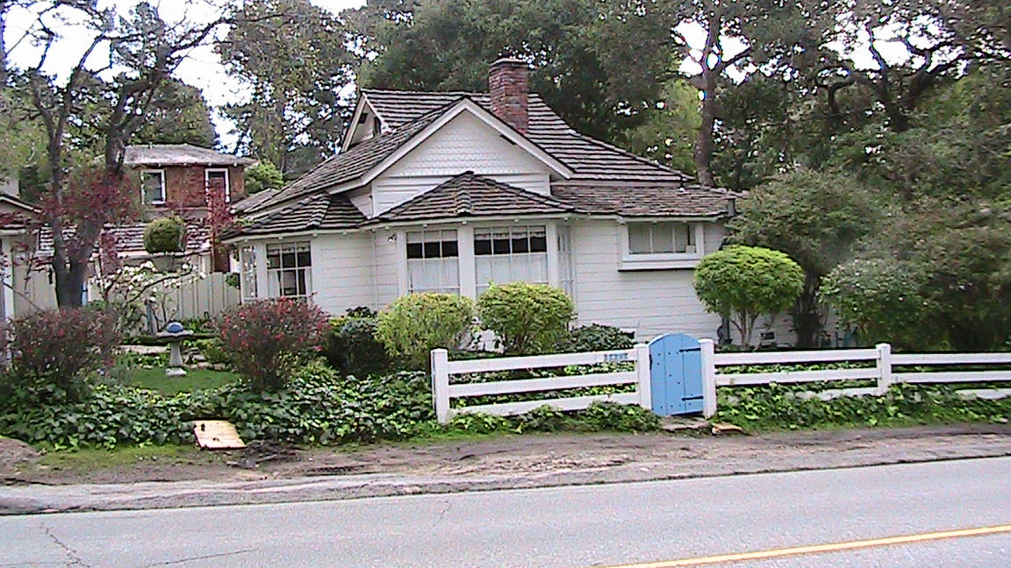
The Berne Family Home Carmel, California
Notes:
This is the Eric Berne family home.
One day I received a phone call from Janice McGee (Eric Berne’s daughter) and she said, quote:“We have sold the Carmel house and I’m wondering if you can come down here and pack up the contents of my father’s study and store it all for safe keeping.” So, of course, I said “yes”. That night I sat at dinner in Eric Berne’s house surrounded by his children as they decided who would take which items from the home in which they had all been raised. When I got home and unloaded the boxes from my car I began to look through them and realized what incredibly valuable history was contained in them. And that is how this project began.

Slide 4
The Family Home
Notes:
This is where the Berne family lived for 61 years. I want to thank Gloria Noriega who is a member of the “Archive Team” for these photos!

Slide 5
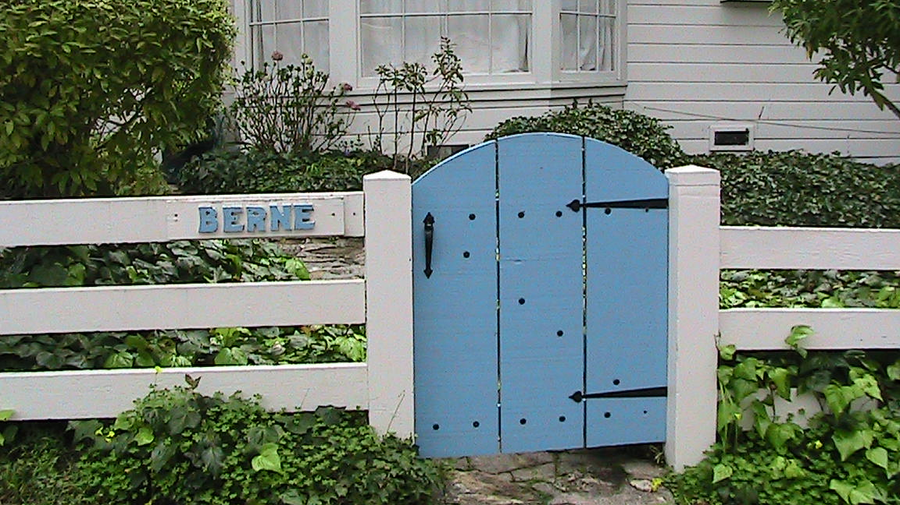
The Gate
Notes:
You can see the name Berne hand carved by the gate.

Slide 6
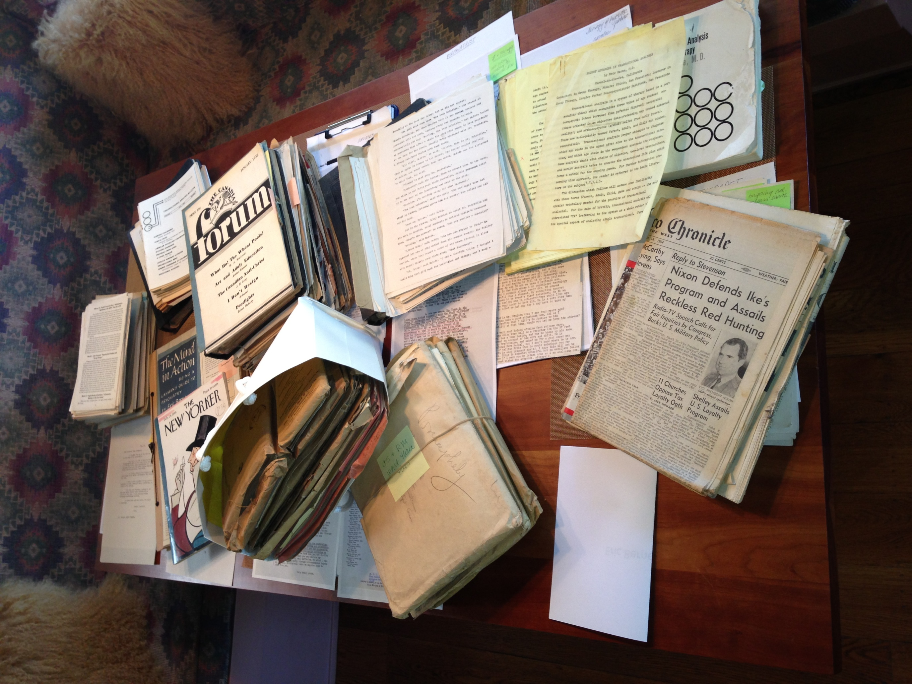
Archives Material
Notes:
This is a photo of my dining room table with some of the archive material.

Slide 7
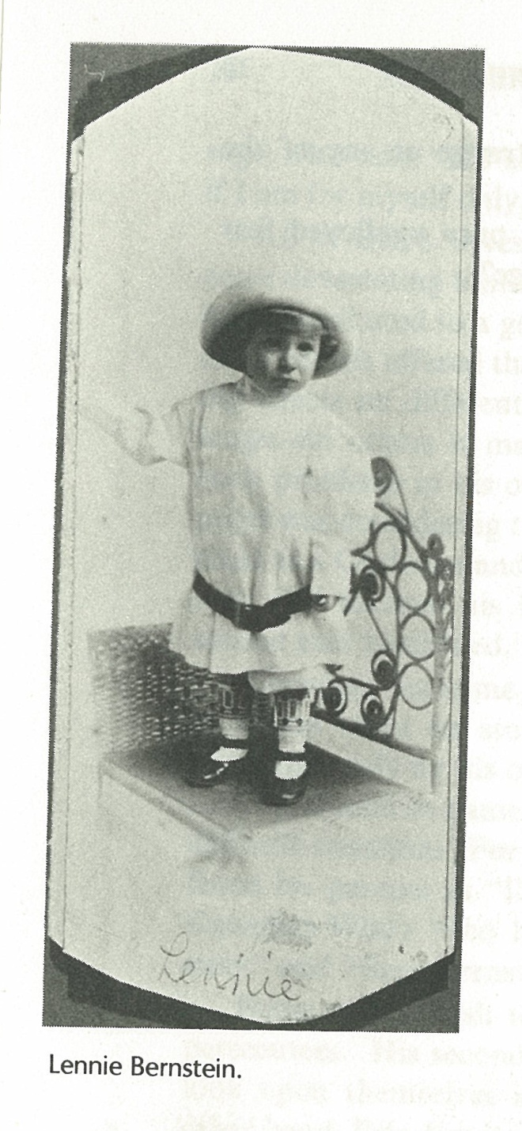
Eric Leonard Bernstein
Notes:
Now some photos from the Archives of the man who has taught us so much. I don’t need to introduce Eric Berne to this audience so here is a quick visual summary of his life.
Eric Leonard Bernstein at about 18 months old.
He later changed the spelling of his first name from L-o-e-nard to L-e-n-nard.

Slide 8
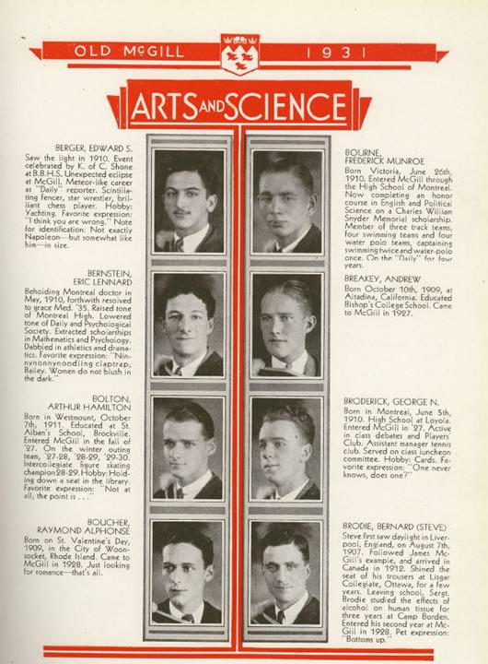
Old McGill, 1931
Notes:
At age 21, he graduated from McGill, this is a page from his yearbook.

Slide 9
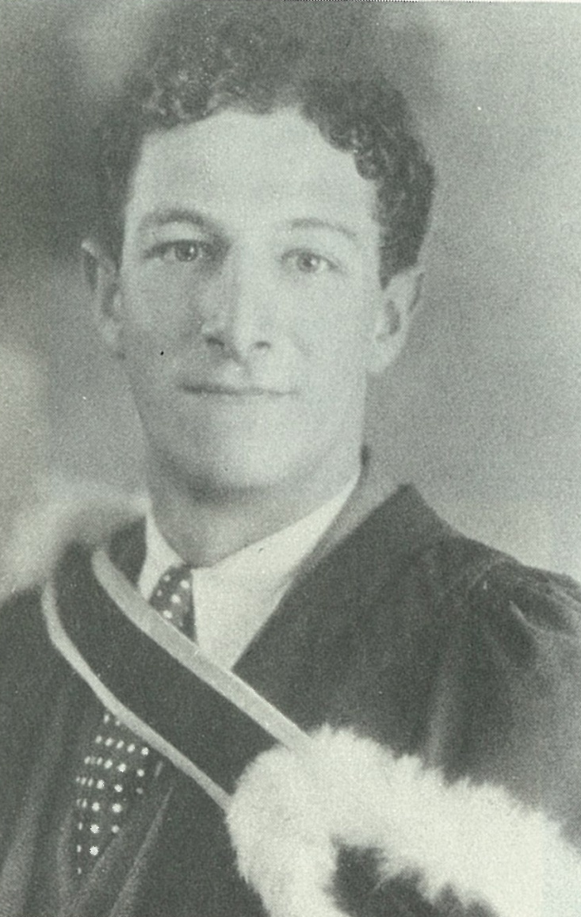
McGill Graduation, 1931
Notes:
Eric graduated with two majors, one in mathematics and the other in psychology.

Slide 10
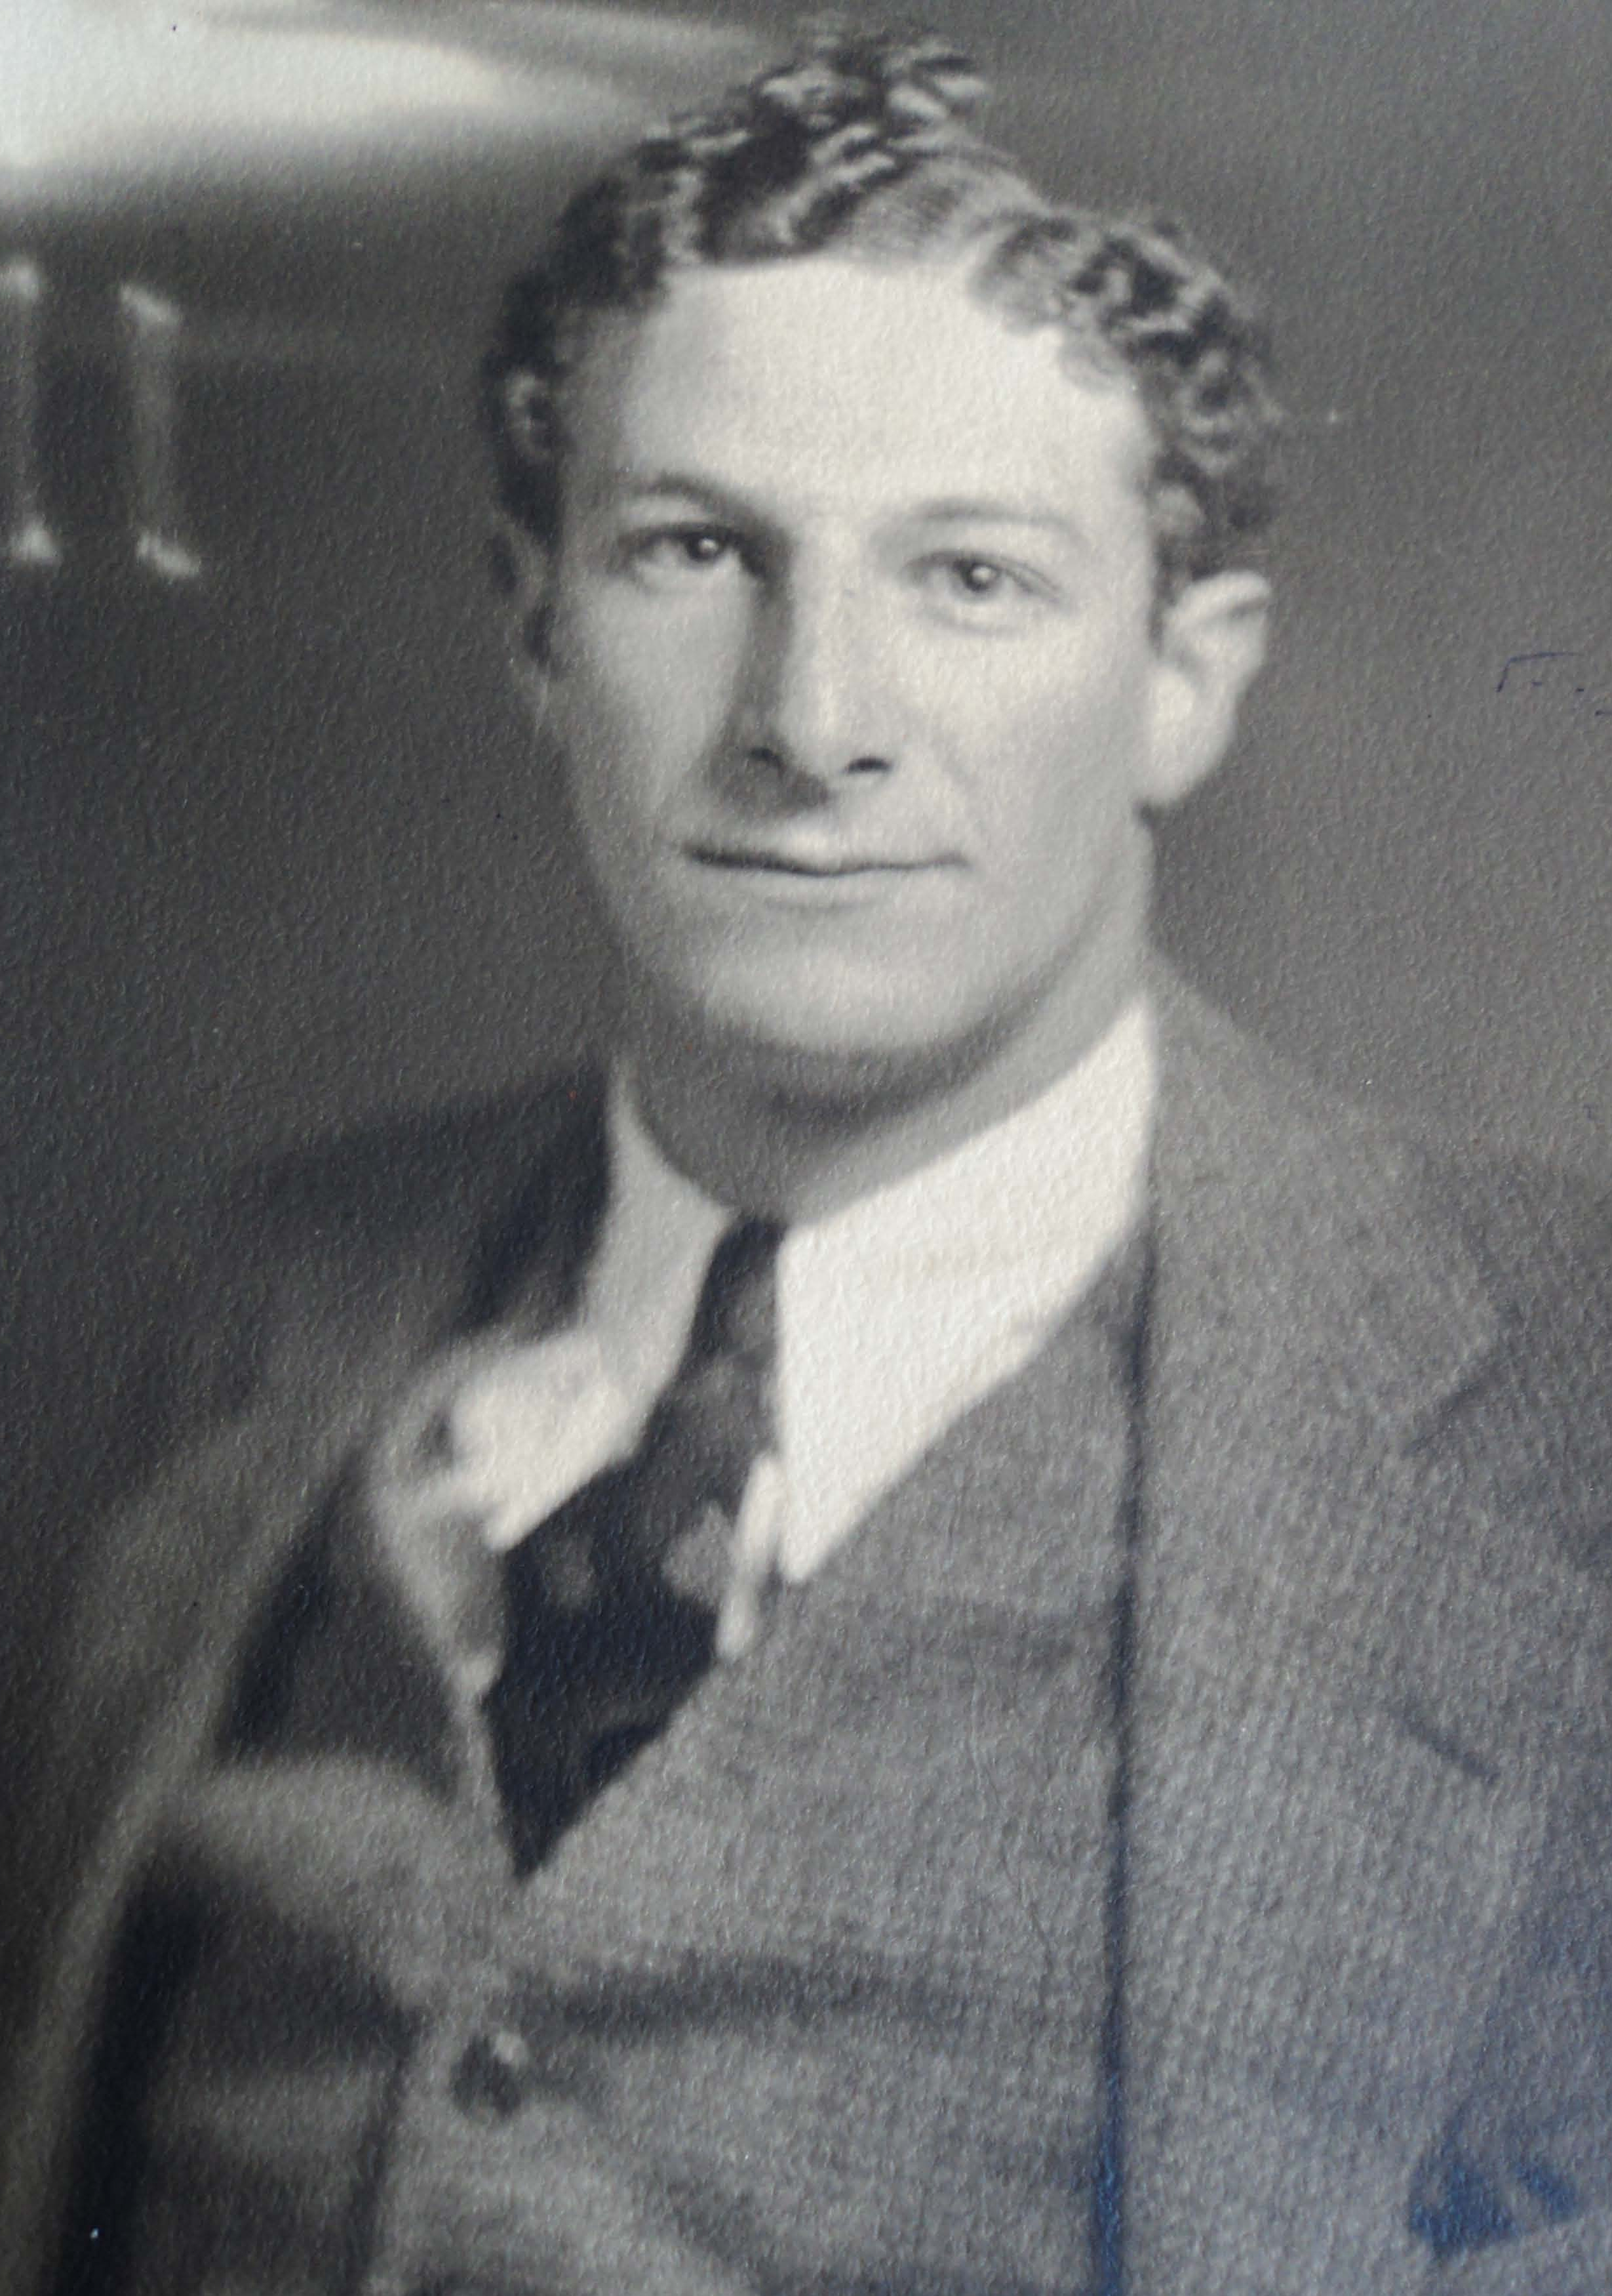
Notes:
Thanks to Janice McGee, Eric Berne’s daughter, for sharing many of the photos shown here.

Slide 11
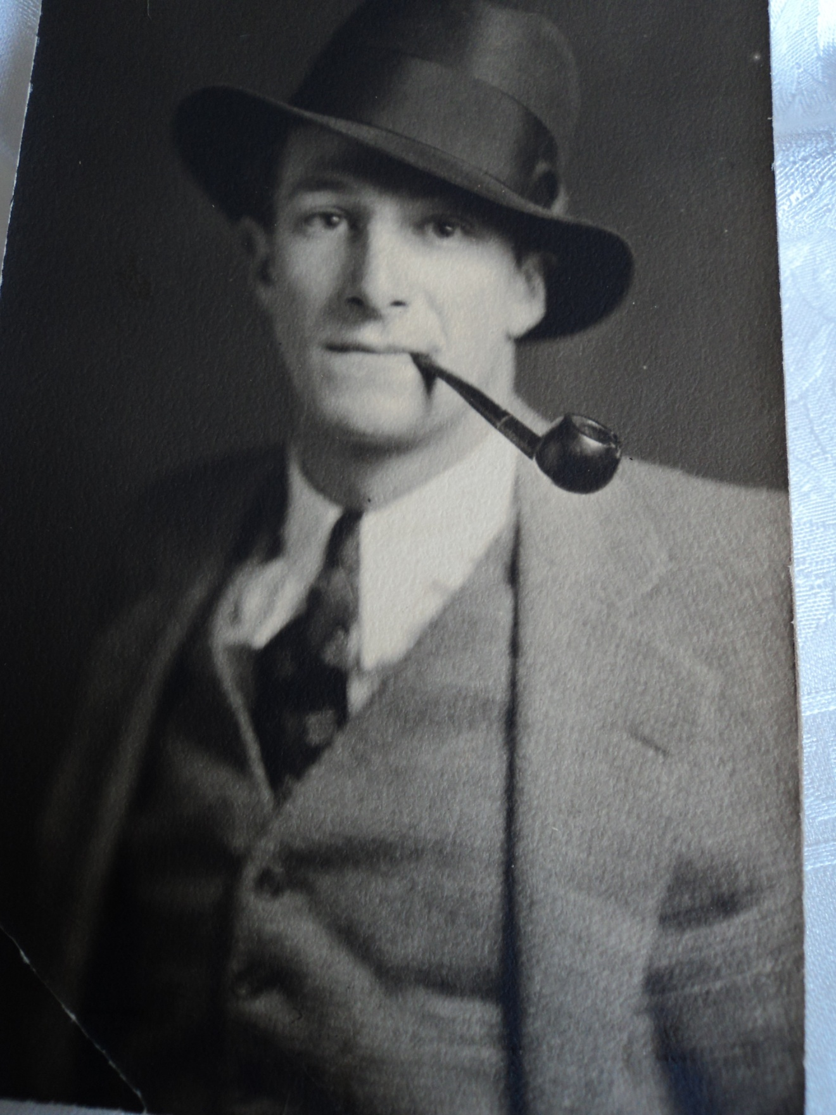

Slide 12
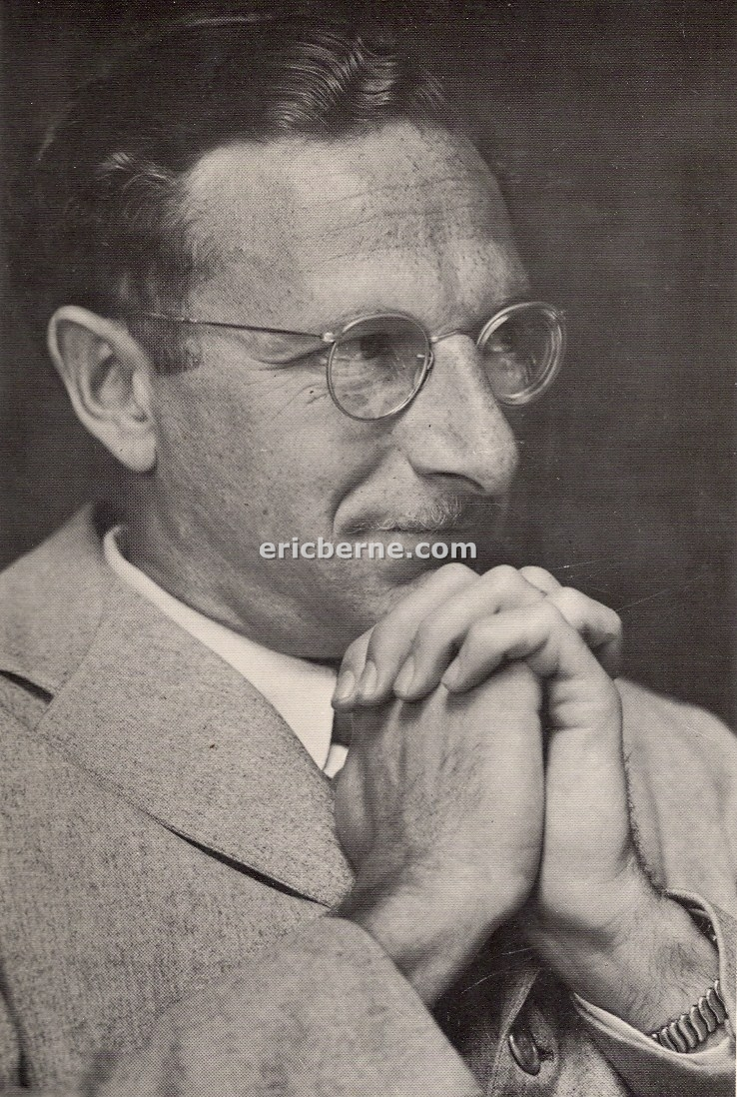
[Games Photo]
Notes:
This is the best known photo from the cover of Games People Play. Thanks to Eric’s grandson, Nick Calcaterra, for this copy of the photo. Nick created the website ericberne.com and you can go there to learn more about our founder.

Slide 13
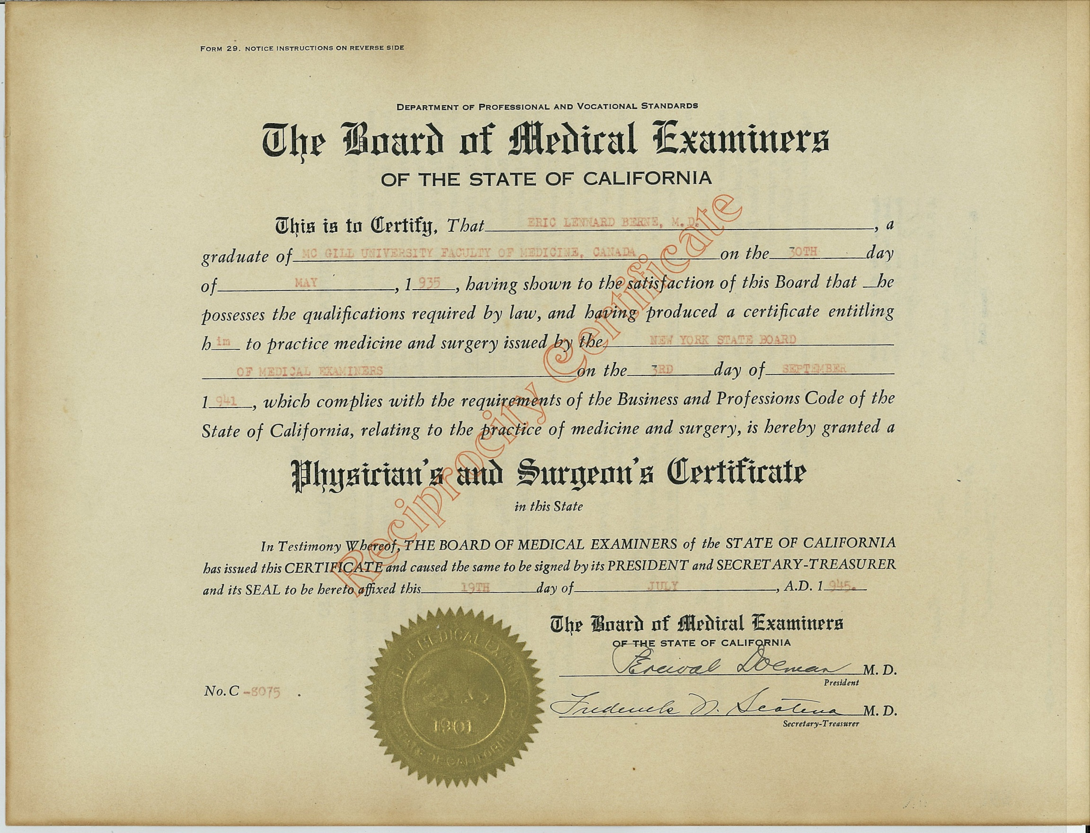
Medical License, 1945
Notes:
Here is Eric’s Medical License to practice in California.
He was also licensed to practice in Massachusetts, Connecticut and New York before he came to California

Slide 14
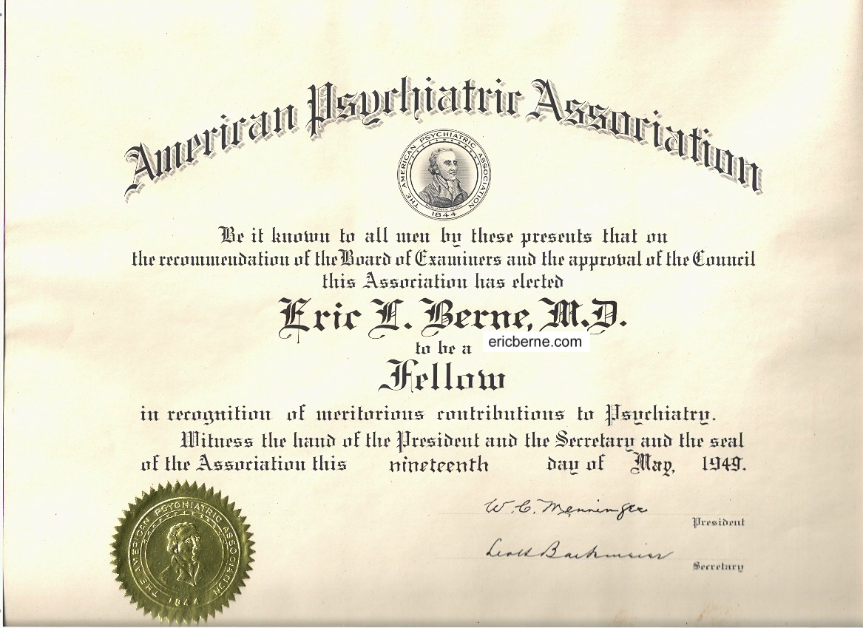
APA
Notes:
Eric became a fellow of the American Psychiatric Association in 1949. The certificate says, quote: “in recognition of meritorious contributions in psychiatry”.

Slide 15
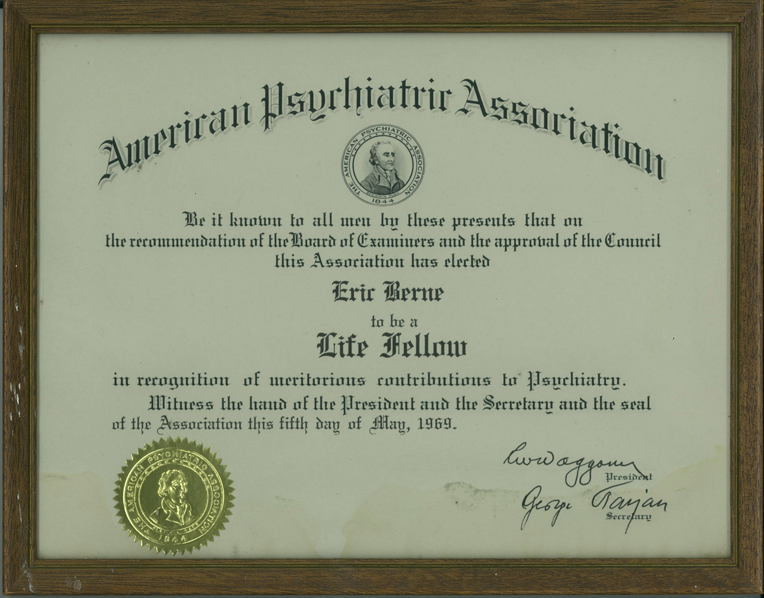
American Psychiatric Life Fellow, 1969
Notes:
Twenty years later he became a Life Fellow of the American Psychiatric Association in 1969, just the year before he died. This was an honor that came at the very end of his life which I’m sure he appreciated.

Slide 16
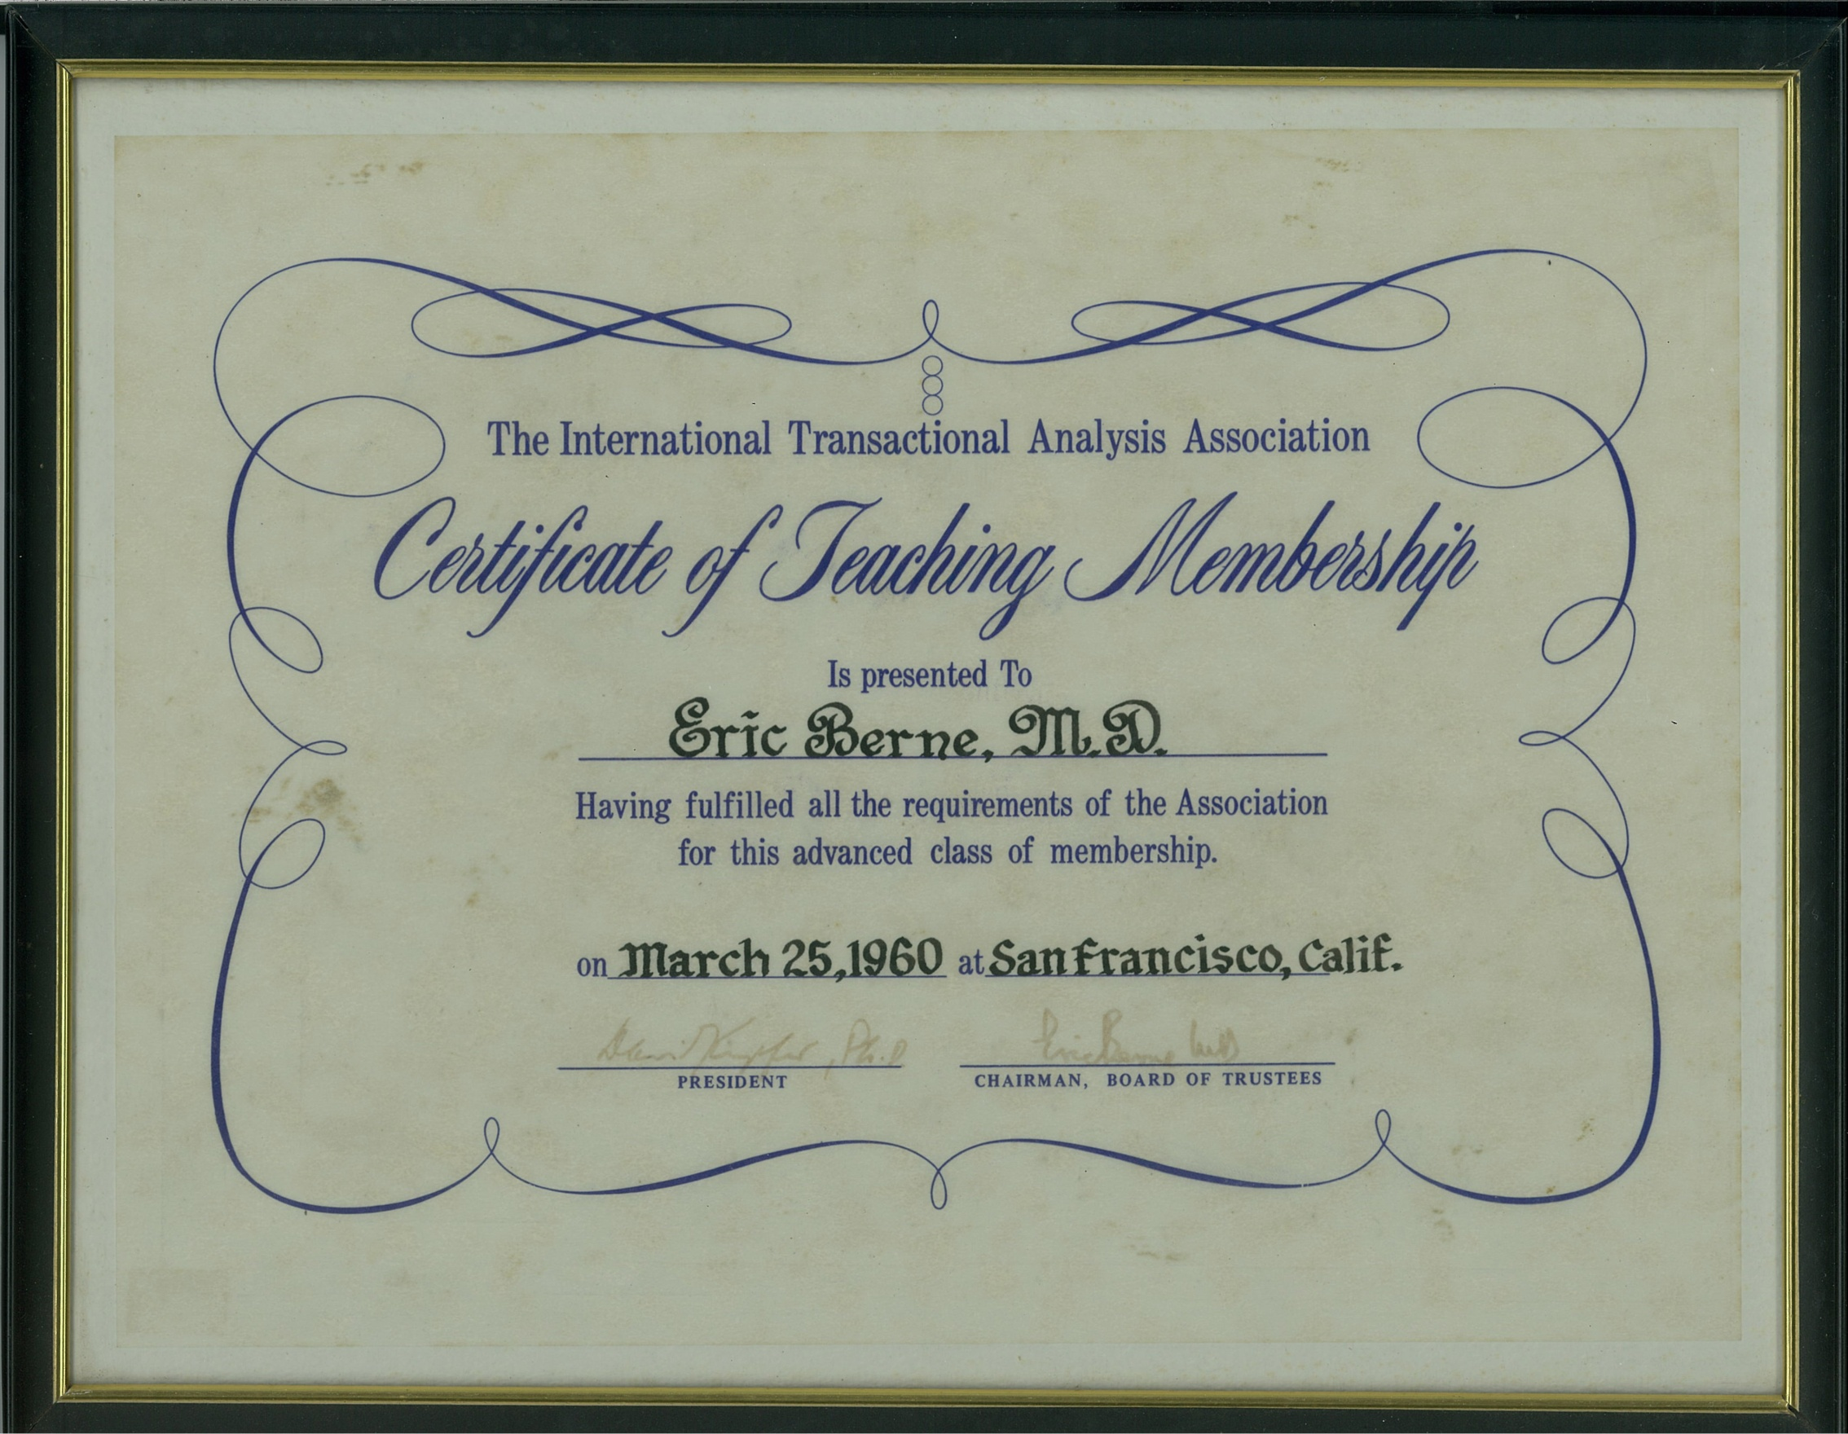
Teaching Member Certificate, 1960
Notes:
Eric’s Teaching Member Certificate for the ITAA. Signed by David Kupfer, then President of ITAA, and by Eric, himself, as chairman of the Board of the ITAA, in March of 1960.

Slide 17
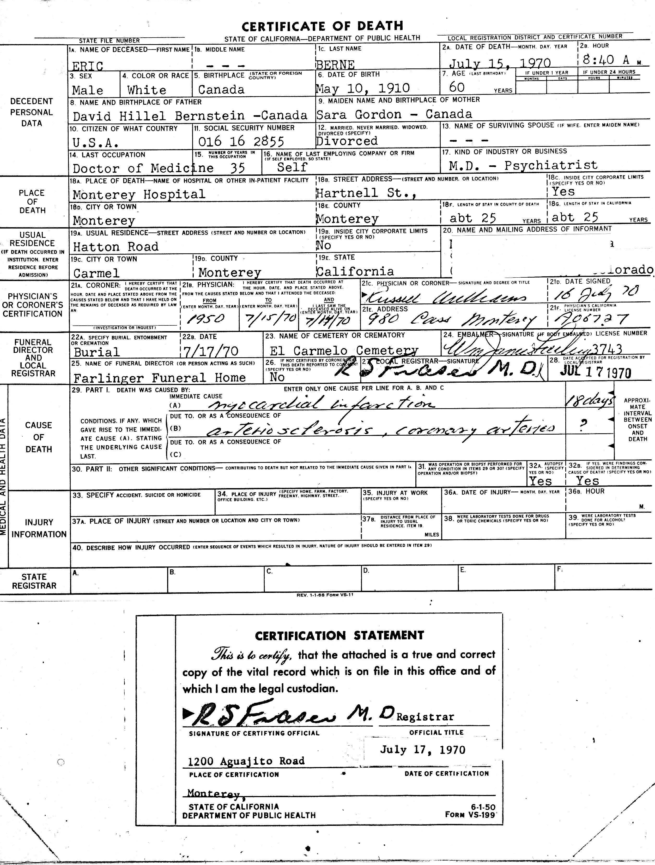
Death Certificate, 1970
Notes:
Here is Eric’s Death Certificate: showing he died of the heart attack, on July 15th, 1970.

Slide 18
Inventor
Notes:
Now I’ll tell you some things about Eric that you might not know. Eric was interested in both mathematics and psychology and had thought about becoming an electrical engineer. He wrote to a friend that, after becoming a psychiatrist, he might go back to school and get his degree in electrical engineering…saying, and I quote: “Surely there is room in the US for one or two combined degrees in psychiatry and electrical engineering.” He was an inventor and his thinking was clearly ahead of his time.

Slide 19
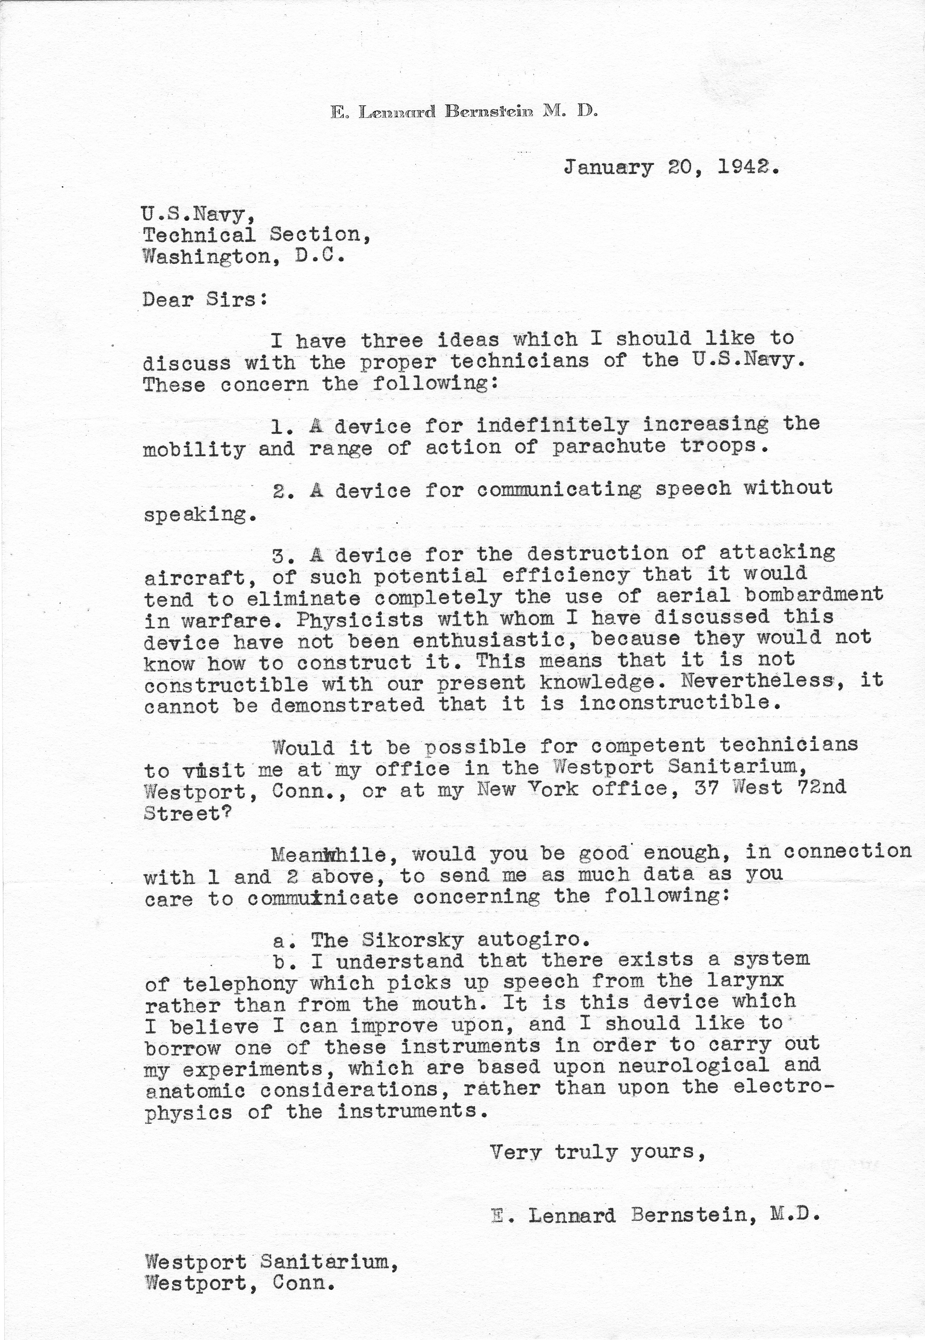
Inventions for Navy, 1942
Notes:
His letter to the US Navy describes three of his ideas for inventions. The one I was most impressed to find was the one where he envisioned a self-driving car and described how it would work. And now Google is working on the self-driving car.

Slide 20
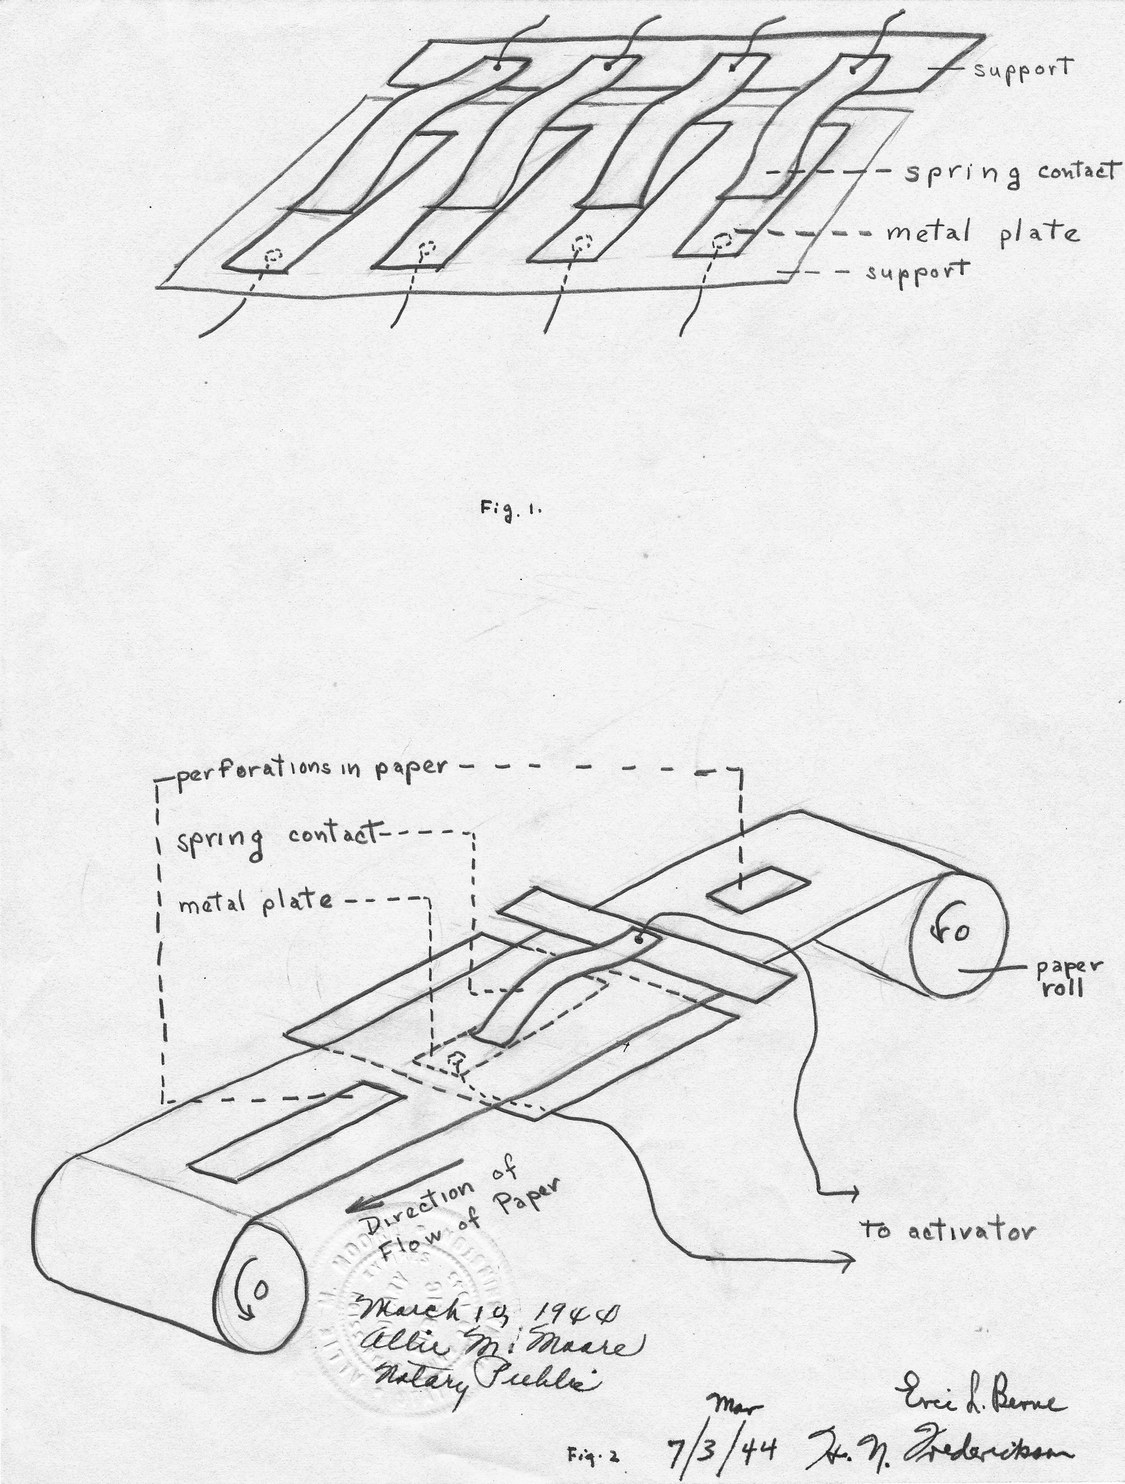
Drawing of Invention
Notes:
These are drawings done by an electrical engineer of, quote: “A device to control vehicles, machines, and electrical devices without human agency once the mechanism is set in operation.” You can see in the bottom right corner that each page is signed by Eric Berne and the electrical engineer.

Slide 21
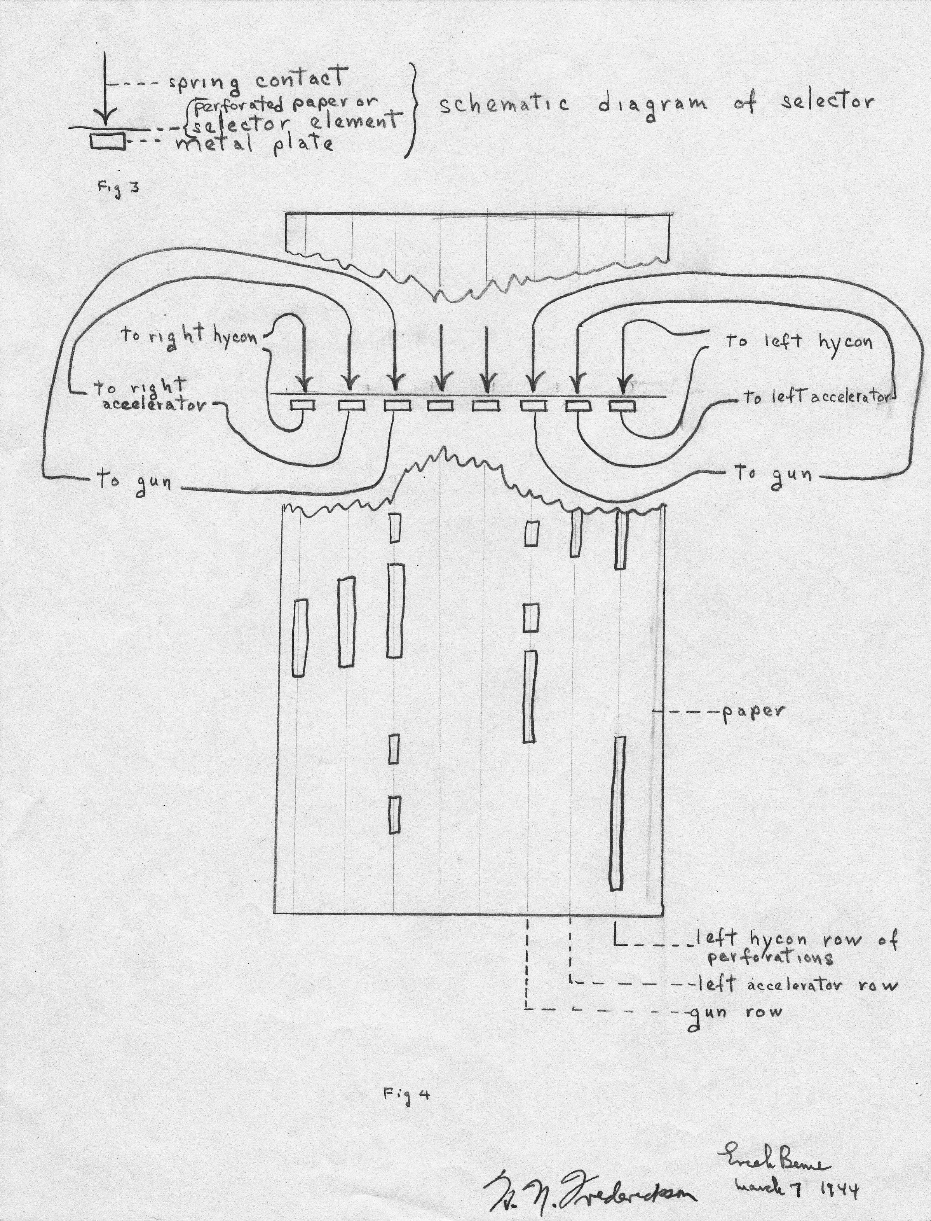
Drawing of Invention
Notes:
Page 2 of diagram of self driving car.

Slide 22
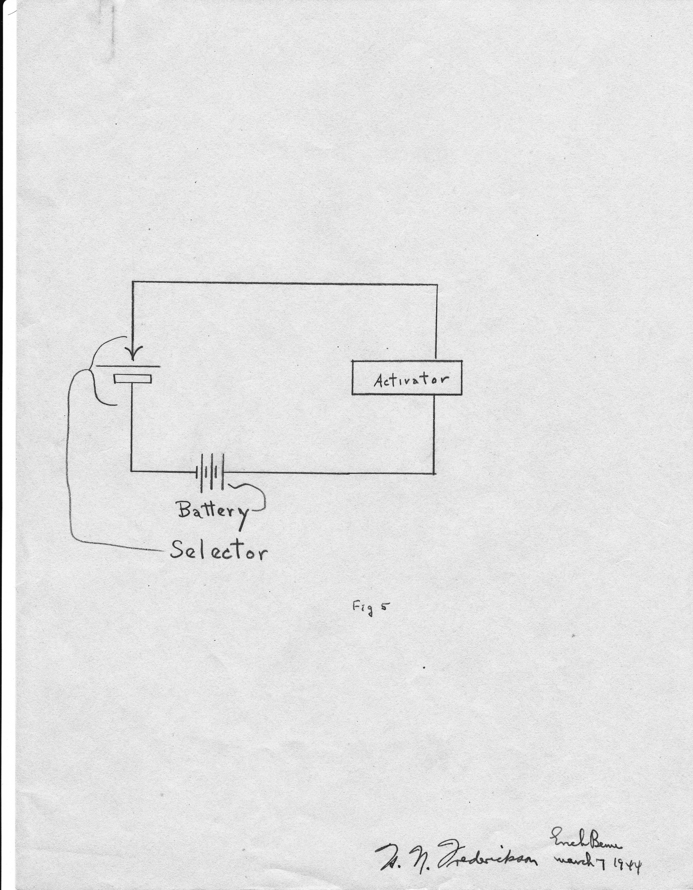
Drawing of Invention
Notes:
Page 3 of same

Slide 23
The Person
Notes:
Eric was a complex, many-faceted, extremely intelligent person and we know from his professional writings only the tip of the iceberg as to who the man really was. Eric wrote almost constantly. He kept a journal of his life and wrote hundreds of letters. He said in one letter to his first wife, Ruth Harvey, that he wanted to record everything in his life because, and I quote: “I am the only person who I can fully understand and I will be able to look back and analyze myself completely.” He was a genius with an IQ of 200, but also a young man with problems of his own. One very important focus of Eric’s early professional life, but one that had significant meaning to him personally as well, was his desire to obtain training in psychoanalysis. Eric was very insecure about money as there had not been enough for his family after his father’s death, when Eric was only 10-years-old. He was fearful and anxious about loss and wrote many letters during his courtship with, and marriage to Ruth in which this fear of loss showed up clearly. He also seemed awkward socially. Though he had a very active social life, one has the sense, when reading those early letters, that social connections were not necessarily easy for him.

Slide 24
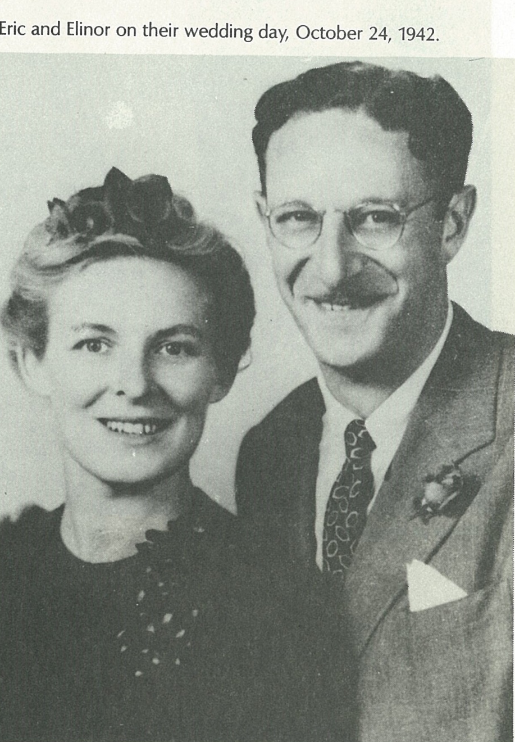
The Decade of his 20’s
Notes:
The most fascinating thing for me in studying the Archival material, was reading the hundreds of letters he wrote to friends, family, patients, colleagues, and the most interesting were those he wrote to Ruth, the woman who would become his first wife. Eric’s first wife was Ruth Harvey. At the time that the Jorgenson’s interviewed her for their book she chose to use the pseudonym, Elinor. This is why you sometimes see her name listed as Elinor as it is in the photo above. Her grandson has suggested that I use her real name to avoid confusion going forward. The decade between Eric’s graduation from McGill in 1931 and his marriage to Ruth in 1942, the decade of his twenties (roughly), helps us to understand some of his insecurities (particularly about money and loss), his tremendous drive for professional advancement, and his vast hunger for learning.
On a personal note, when I was 19-years-old and in therapy with Eric Berne I saw him as a kind and straight-talking father. And that was the image I maintained of him for many years. As I read these letters from such a young period of his life…letters filled with emotion, confusion and insecurities but also hopes for a bright future and happy life, I felt very nurturing towards him. I became aware of all the struggles he had had, and felt a lot of compassion for him.

Slide 25
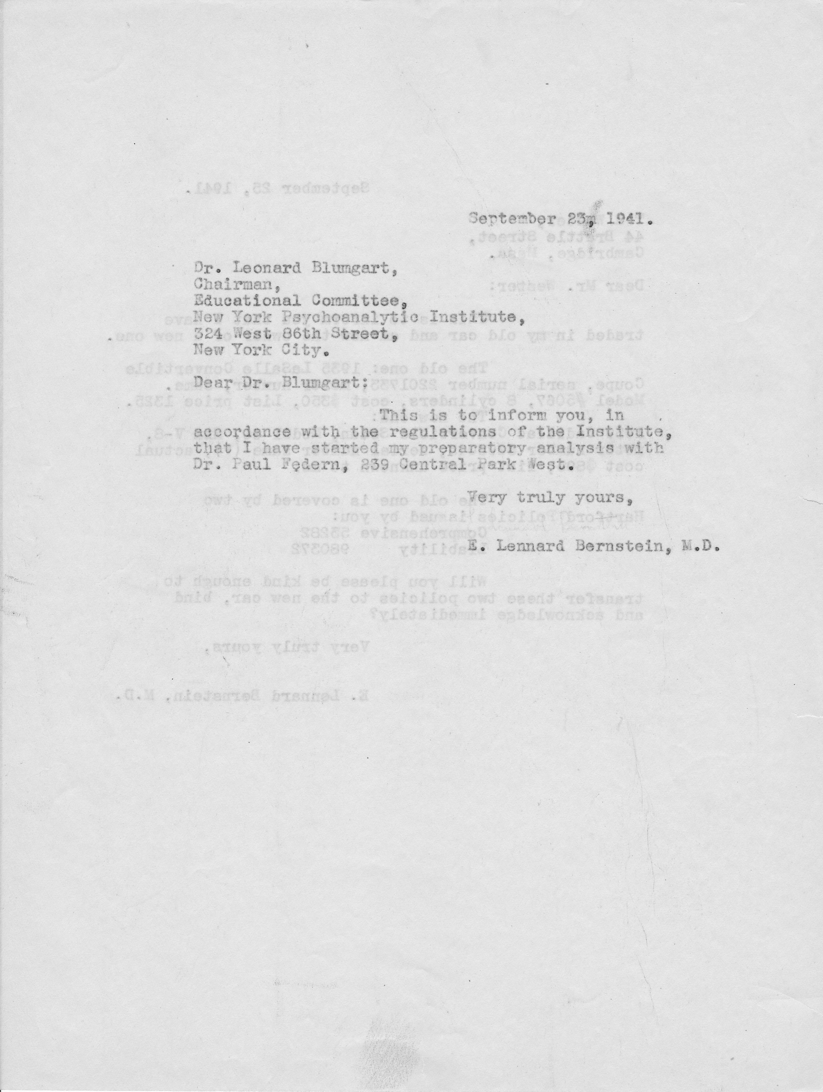
Letter: Formal Beginning of Analysis
Notes:
Eric had approached psychoanalytic training programs in Chicago, Philadelphia and New York and was very happy and proud to be accepted into the New York Psychoanalytic Institute. When his analysis with Paul Federn began he wrote to friends and family members with the good news. His anxiety about the cost was an ever-present concern. This letter says:“This is to inform you in accordance with the regulations of the Institute that I have started my preparatory analysis with Dr. Paul Federn, signed E. Lennard Bernstein”. Letter dated September of 1941
Later he wrote to a friend saying, quote : “My consulting analyst is Paul Federn, who used to be Freud’s first assistant. He is an old, grandfather of an analyst who, in ordinary times, would long ago have retired, so I am very lucky to have him. He is a very wise man.”
Eric and Paul Federn kept their relationship alive through letters and visits for the rest of Federn’s life. When Paul Federn was dying of cancer, and his wife was no longer alive to look after him, Eric and Dorothy, Eric’s second wife, spoke to Federn by phone and invited him to come and live with them in Carmel for the remainder of his life. He declined. Two weeks later, Paul Federn committed suicide.

Slide 26
Eric Berne and Ruth Wedding Day
Notes:
While Eric was pursuing his analysis he was also pursuing a woman who he found to be beautiful, bright and talented. Eric was completely infatuated and in love with Ruth, the woman who became his first wife, and there are hundreds of personal letters documenting his feelings for her during their romance and courtship, relationship, marriage and divorce. His insecurity about potential loss shows up clearly. Both before and after the divorce, he felt great distress at being separated from his daughter, Ellen.
(Note: Ruth chose to use the pseudonym Elinor for the Jorgenson’s book and that is why the clipping carries the name Elinor. Her real name was Ruth.)
In these letters, it is clear what an important role being a father had in Eric’s life. He wrote that children needed a father in order to grow up to be healthy and secure human beings. Three weeks before he died, he took a walk with his son Terry, who was 15 at that time, and said “A father should never die before his children are grown.” (personal communication)

Slide 27
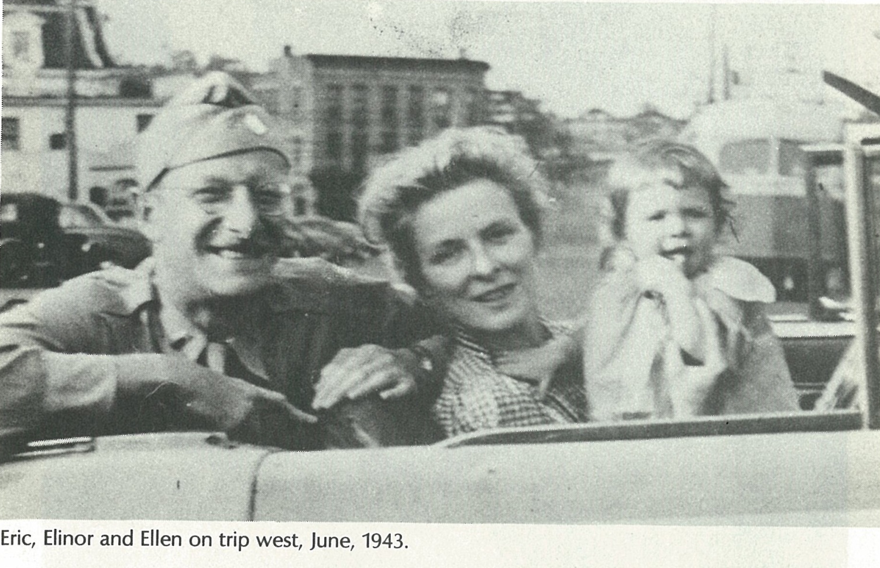
Eric, Elinor and Ellen
Notes:
When Ruth came, with baby Ellen, to join Eric and to start their life together in the West it was one of the happiest times for Eric. He had looked forward to all of them being together, finally. The end of this marriage was extremely difficult for him and the most emotionally painful aspect was not being able to raise his daughter, Ellen. Eric’s son, Peter, was born after Eric and Ruth had already separated.
Eric ‘s divorce from Ruth was final in 1946.

Slide 28
Marriage to Dorothy Way
Notes:
Eric met Dorothy Way in 1947, the year after his divorce, and they married two years later.
Here is the newspaper clipping of Eric’s second marriage to Dorothy Way in 1949. On the right is the clipping about the birth of their first son, Eric David Berne, born on March 22, 1952 and who goes by the name Rick.

Slide 29
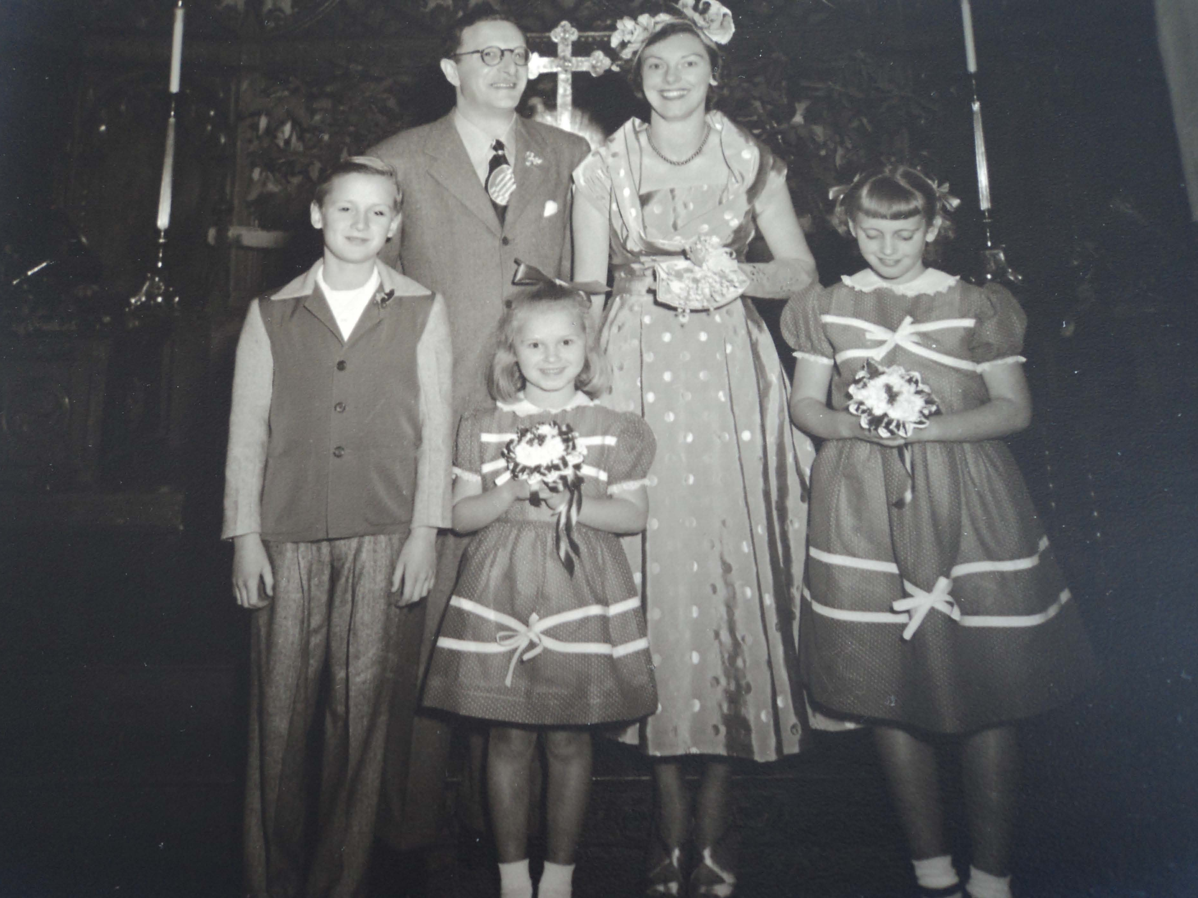
[Photo of Eric and Dorothy Way or whole family]
Notes:
When he married Dorothy Way she had three children by her first husband: a son Robin, and two daughters Janice (center) and Roxanna (far right). Roxanna was nine years old when Eric and Dorothy married, and fifteen when she was killed in a tragic car accident. Eric and Dorothy had two sons, Rick and Terry. They raised the five children living in the Carmel home together for twenty years.

Slide 30
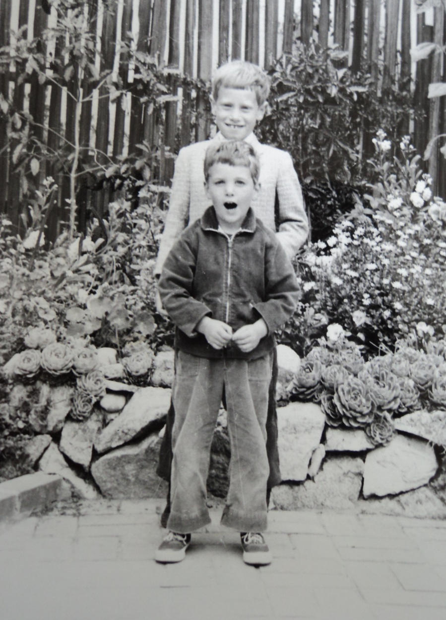
Rick and Terry
Notes:
Rick (older) and Terry (younger) are the children of Eric and Dorothy.

Slide 31
Psychiatrist
Notes:
Eric Berne was known and loved by many for the work he did as a psychiatrist. He was a staunch supporter of his patients’ needs. His values said he should take care of others to the best of his ability and he did that even when he had to go out of his way to do so. It is not possible to separate the person from the psychiatrist in talking about Eric Berne. His values and beliefs about helping others were there from the very beginning of his life. In one letter he says that he had wanted to be a psychiatrist from the age of six on.

Slide 32
Your donation welcome!
Please become one of our supporters and donate to the Eric Berne Archive Fund at
EricBerneArchives.org
Every donation will serve to increase the size of the Eric Berne Collection at the University of California in SF. We welcome your participation and we are grateful for your help!
Notes:
This slide presentation was compiled by Carol Solomon who, with a group of colleagues, is raising funds for the completion of the Eric Berne Archives. You can contact her directly at solomon.phd@gmail.com
You may also contact other members of the Archive Team:
Ann Heathcote, UK ann.heathcote@btinternet.com
Marco Mazzetti, Italy marcom.imat@gmail.com
Gloria Noriega, Mexico gnoriega@imat.com.mx

Slide 33
On Curing People
Notes:
Before reading more about Eric Berne, the psychiatrist, I’d like you to be able to hear Eric’s voice. Please double click on little speaker icon to right of photo. Here he is talking about curing people. He says: “If you want to cure people you have to change what’s in their head. You can’t cure someone by changing their environment, you have to change what’s in their head. So their heads will look different. We think that a great many psychiatric disorders are caused by parental programming or tapes in the head.”
My thanks to Claude Steiner for editing the original tapes of the San Francisco TA Seminar, and for lending them to me so that I could listen to them for my work on this project. Please double click on the speaker so that you can hear Eric’s voice.

Slide 34
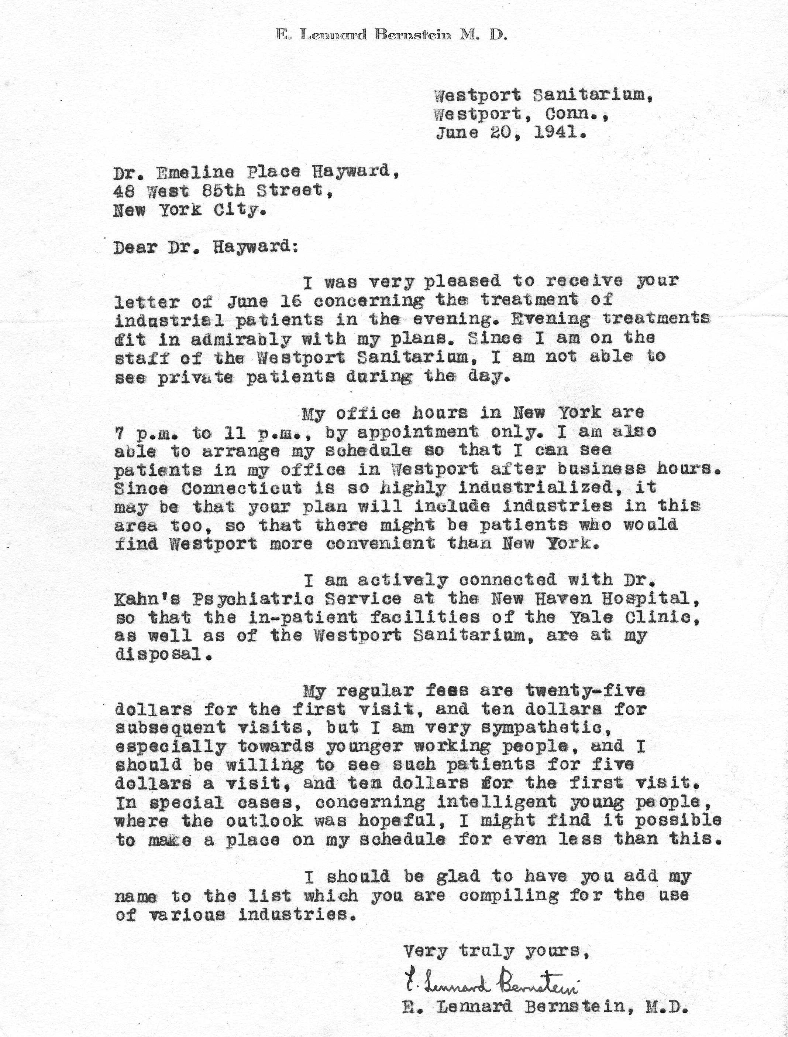
Practice Ideals, 1941
Notes:
Here is a quote from a letter I found where he says: “My regular fees are twenty-five dollars for the first visit, and ten dollars for subsequent visits, but I am very sympathetic, especially towards younger working people, and I should be willing to see such patients for five dollars a visit and ten dollars for the first visit. In special cases, concerning intelligent young people where the outlook was hopeful, I might find it possible to make a place on my schedule for even less than this.” This was a value that he maintained throughout his entire career. He didn’t want to exclude people because of their inability to pay.

Slide 35
Eric’s Values: Money and Medicine
Notes:
When Eric was on the staff of a private hospital he wrote the following to a friend: I quote: “This place where I am working is fun for a while, I guess, but I’m not used to being an employee, and I don’t like it…..Being in a private place, there is a lot of money background to the medicine which I don’t like at all, because I am a doctor, and not a business man, and I don’t ever want to be a business man as far as medicine is concerned.” (italics mine) Signed, Lennard Bernstein

Slide 36
Eric as Patient Advocate: Letter Supporting Soldiers Needs
Notes:
Eric advocated for people in need in many different settings. He did this unfailingly while working in hospitals, while in the Army, and in his private practice. In this letter he is responding to a published letter in the Army paper criticizing his patients because he had asked for some special considerations for them. Here he is defending what his patients asked for. He says. …We try to keep the sick soldiers on our wards as happy as possible. (italics mine)

Slide 37
Eric Speaking on Learning Psychotherapy
Notes:
I’d like you to have another chance to her Eric’s voice so I have chosen a section in which he tells us what we need to focus on when learning psychotherapy. Please double click on the speaker icon.
“The first thing you have to learn is simple, pure psychotherapy. In other words, there’s a patient sitting there in a chair and you’re sitting there in a chair and there are no gadgets. There are just two people. That’s all there is. So the real psychotherapist’s problem is ‘What do I do when I am in a room with a person who is called a patient and I am called a therapist?’ There are absolutely no gadgets; no note papers, no tape recorders, no music, nothing. So that’s how you learn to do psychotherapy.”

Slide 38
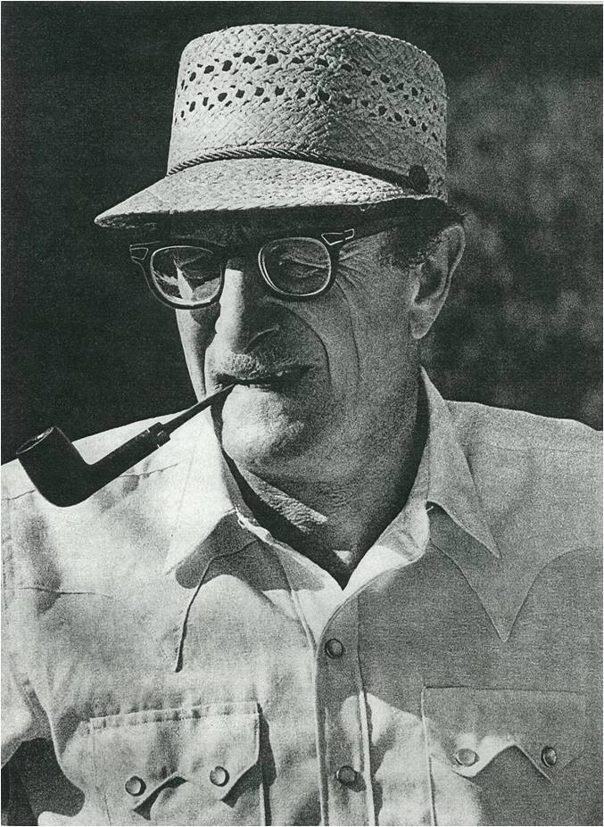
Eric Berne on Scripts
Notes:
I’d like to play again some of Eric’s voice. Please double click on speaker icon to the right of the photo. This is what he said about Scripts: “Children have always had pretty much the same problems and pretty much the same weapons; their weapons are all psychological. I’m sure the weapons and the problems of the 4-year-old in cave man days are the same as they are today, and they have to handle them in the same way…by doing what Mother said, or not doing what Mother said, or doing what Father said, or vomiting or getting a pain in the belly or whatever it may be. So that’s how it goes back historically. Four-year-old kids have had the same problems ever since there were human beings.” (italics mine)
“And that’s why it (the Script) has a really grand historical perspective: not like 2,000 years but maybe 50,000 years or even 500,000 years.”
“So the Script is formed in childhood and that’s why they have always been the same because the problems have always been the same for children at script forming age.” (italics mine)

Slide 39
Interpretation About Money
Notes:
Audio of Eric’s voice talking to the seminar about an interpretation to a patient who had “money issues”: “Well, look, that should demonstrate what I’ve suspected from the beginning which is that this whole business about money is just a rationalization; you are allowed to be worried providing it’s about money. But you are really worried about something else. Because it’s a four-year-old kid who is saying to me “when I walk in the room and instead of talking to me you shuffle through papers”…when you are four years old it doesn’t have anything to do with money. It’s just that your feelings were hurt about something but now you’ve got to rationalize it and say it’s about money.”

Slide 40
Intuition
Notes:
Eric had a tremendous intuitive sense and those who knew him were often amazed at how much he could know about you so quickly. He was very interested in intuition and wrote six articles on the subject. You will be able to read all of these online when the digital collection at the University of California is complete.
Many years before his own writing on intuition, Eric wrote to Gertrude Stein, who was a famous author, art collector, and researcher, about her work and research on automatic writing. Automatic writing was a process where the writer tuned in to a spirit, and the premise was that the person who wrote was writing the thoughts, feelings and beliefs of that spirit.

Slide 41
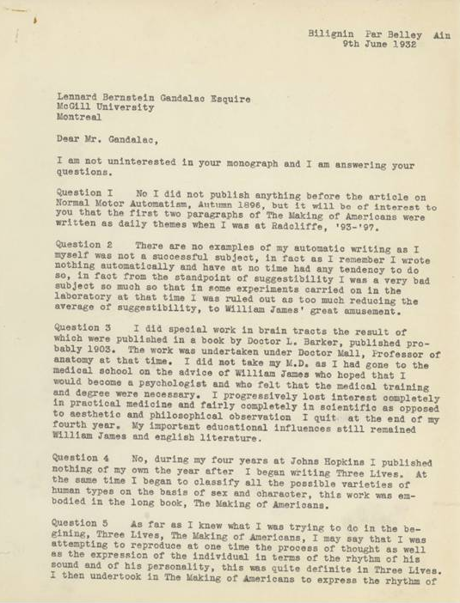
Gertrude Stein Letter, 1932
Notes:
In his letter to Gertrude Stein, he had asked seven questions which she answers here, and he had expressed that he was interested in doing research with her about her automatic writing but said that it would be better for him, professionally, if he remained incognito (ie unrecognized). So he wrote under the pen name of Gandalac. This is why, in this letter, Gertrude Stein writes: “Dear Mr. Gandalac….”

Slide 42
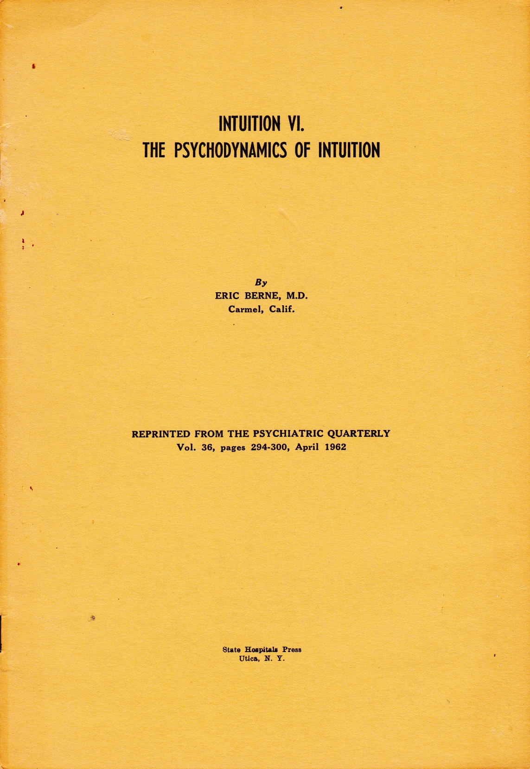
Intuition, 1962
Notes:
This paper “deals with the psychodynamics of intuition: with the internal conditions which promote or interfere with the workings of the intuitive process”. It is the sixth in the series.
These articles and many others will be available for reading in the Eric Berne Collection at the University of California Library. The first part of this collection will become available on August 9, 2014 after it’s unveiling at the TA World Conference in San Francisco. The links to the collection will be made immediately available at ericbernearchives.org which is the website for this Archives project. You can go there to learn more about this project, to check on our progress and to see our list of all donors.

Slide 43
Karl Menninger Letter, 1949
Notes:
Here is a letter to Eric from Karl Menninger, which was written after Eric’s second article on Intuition. I quote: “How courageous and fine of you to put down your experiences regarding intuition in the paper appearing in the Psychiatric Quarterly for April, 1949. I just ran across it. Could you send me two or three reprints? I think it is fine”. Sincerely yours, Karl A. Menninger, MD. This letter came 17 years after Eric’s letter to Gertrude Stein. You can see then that Eric’s interest in intuition was longstanding.

Slide 44
Author
Notes:
We all know Eric Berne as the prolific author that he was. Mostly we know about his professional writings in the field of psychiatry. As I mentioned earlier, Eric wrote under six different names. He said in one letter that when he was younger his work was always more readily received when he wrote under a pen name but that when he used his own name people were not as accepting of what he wrote. On the following slides you will see just a few of the many articles he wrote. All of his published articles will be available on the site of the Eric Berne Archives at the University of California when that collection is complete.

Slide 45
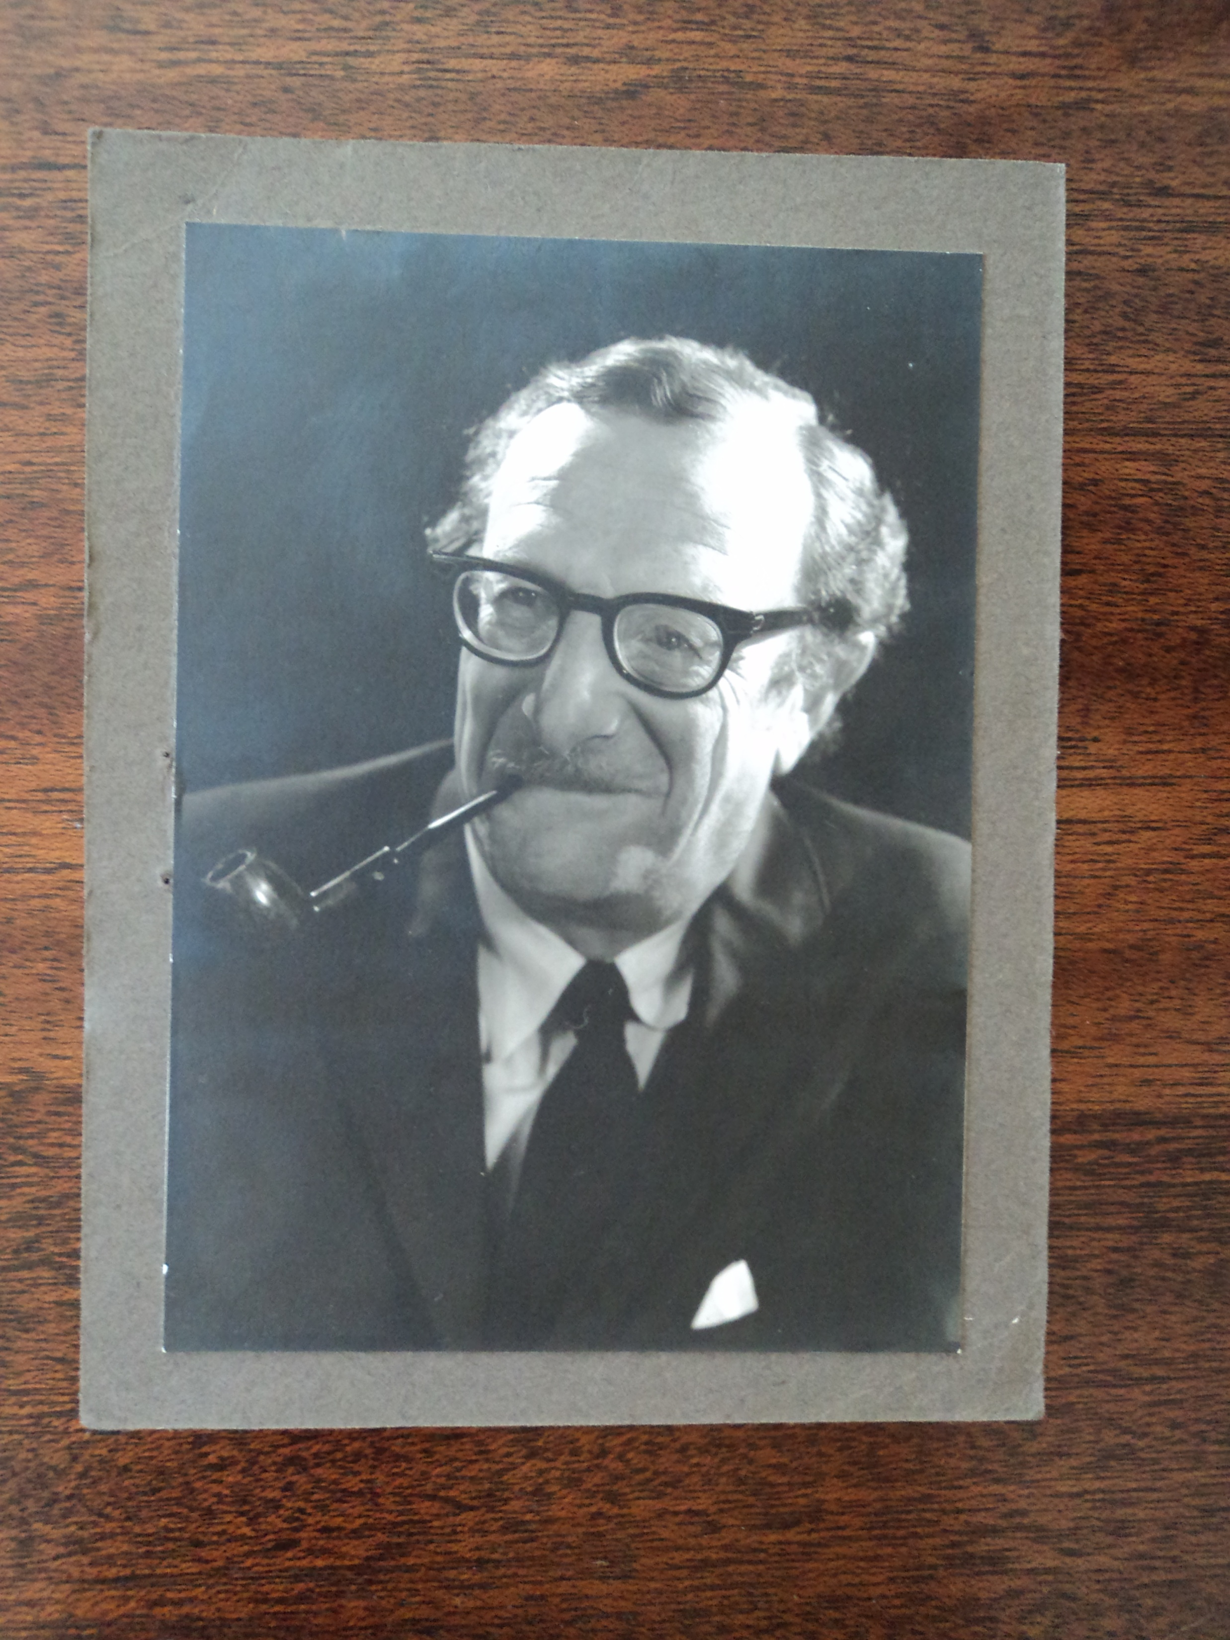
Eric Berne, 1965
Notes:
In Eric’s professional writings we typically see, first, his use of his Adult ego state and secondly his Nurturing Parent. He also had a very active Creative Child Ego state as can be seen by his writings under six different names of comedy, poetry, short stories, plays, inventions, as well as his development of TA and his professional articles and books.

Slide 46
Eric Berne’s Pen Names
Lennard Gandalac
Cyprian St. Cyr
Ramsbottom Horseley
E. Lennard Bernstein
Eric L. Bernstein
Eric Berne
Notes:
Here are Eric Berne’s Pen Names

Slide 47
Eric Berne’s Study
Notes:
This is the study Eric built in the garden of his Carmel home and the place where he did all of his writing. The study still stands in the back yard of the Berne family home which was sold in 2009.

Slide 48
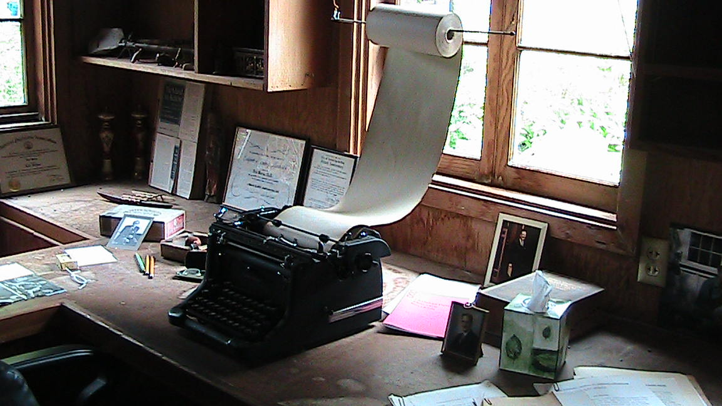
Eric Berne’s Study
Notes:
This is his typewriter and the roll of paper he used so that he would not have to stop and change the page. As I understand, he typed using only two or three fingers!

Slide 49
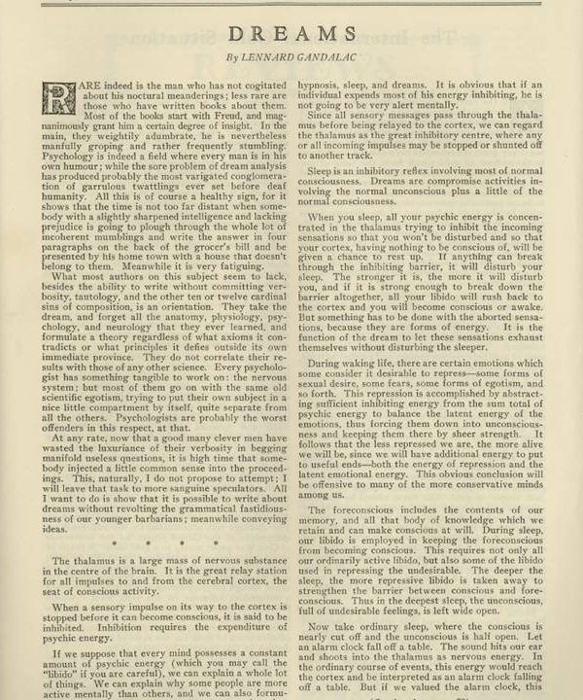
Dreams by Lennard Gandalac
Notes:
Following are some examples of articles that Eric wrote and published. Dreams, Lennard Gandalac

Slide 50
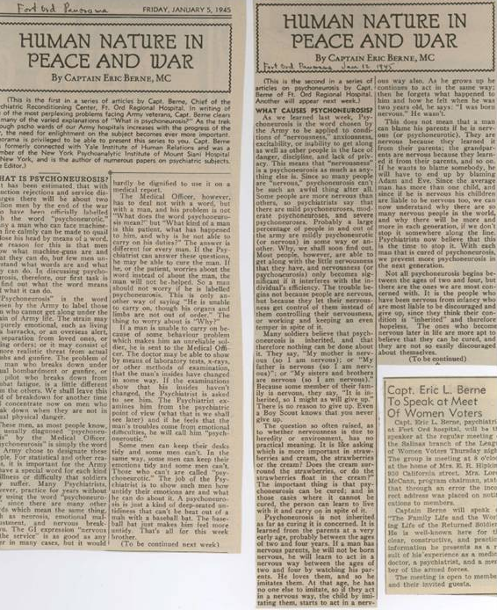
Human Nature in Peace and War, 1945
Notes:
Human Nature in Peace and War, By Captain Eric Berne, MD

Slide 51
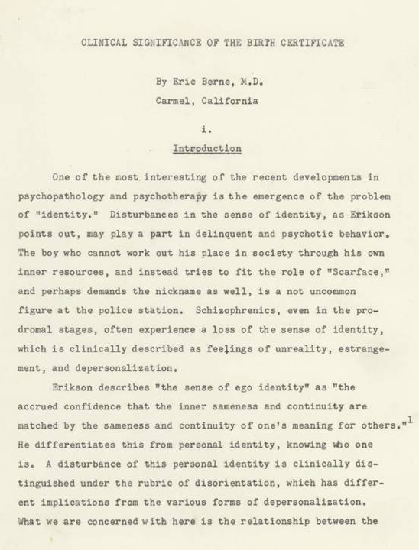
Clinical Significance of the Birth Certificate
Notes:
This was one of my favorite finds. Eric was especially interested in the sense of identity and how that related to one’s name. Many people are aware that he spent a number of years contemplating what name he, himself, would use. He felt some conflict about giving up his given name, that being the name of his father, and in one letter when he wrote to ask to have his own McGill Medical diploma changed to the name of Berne, he said that he would stay respectful to his father’s name by keeping the father’s diploma, in the name of Bernstein, with his own. In this paper, which as far as I know was not published, he explores the significance of the birth certificate (particularly the name on the birth certificate) and how that relates to one’s sense of self.

Slide 52
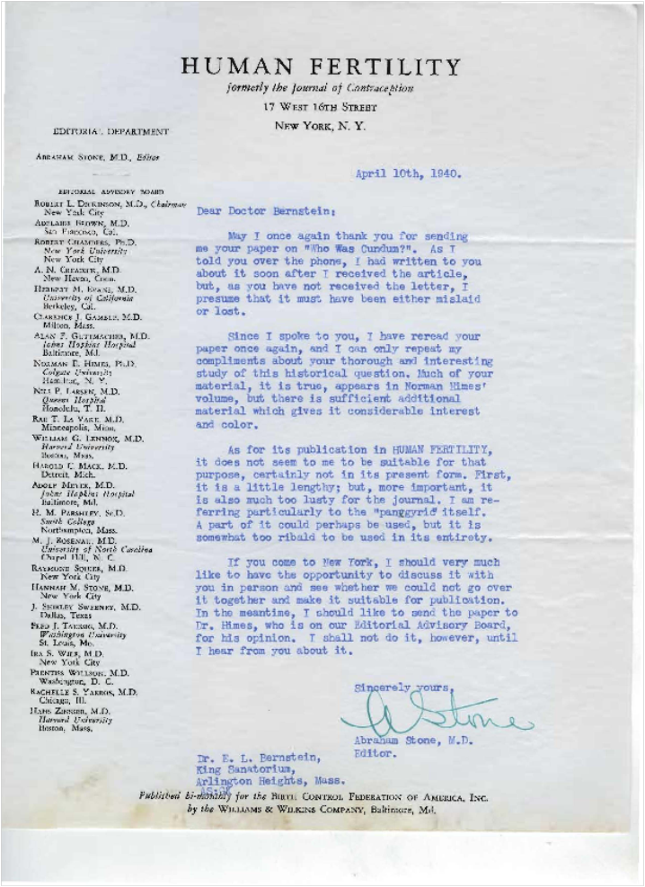
Who Was Condom?, 1940
Notes:
This is a rejection letter from the Journal of Human Fertility for the article Who Was Condom, written in April of 1940. I quote here: “As for its publication in Human Fertility it does not seem to me to be suitable for that purpose, at least not in its present form…first of all, it is a little lengthy; but more important, it is also much too lusty for the Journal” (italics mine). But you will see in the following slide that, indeed, it was published in that Journal in December of 1940. His name here was Dr. Bernstein

Slide 53
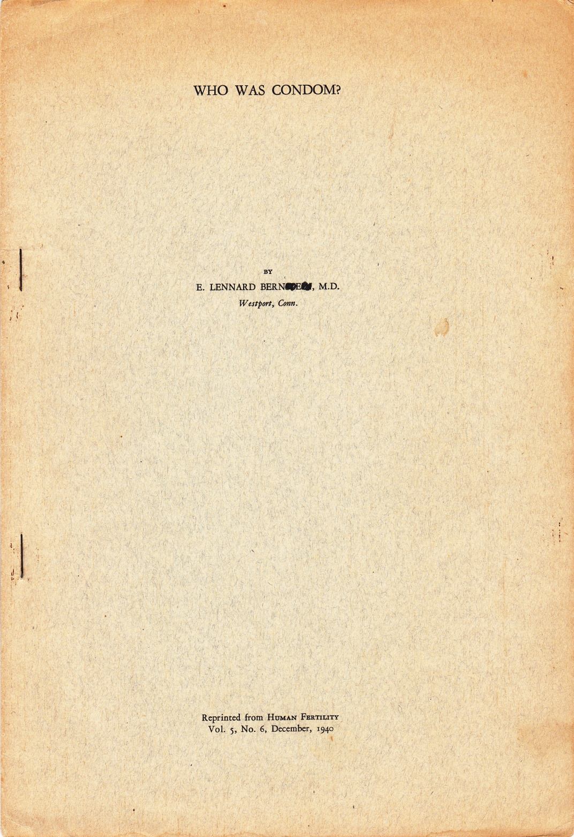
Who Was Condom?
Notes:
Who Was Condom?
Note that the paper was written by E. Lennard Bernstein but that a few letters are scribbled out so that the last name reads Berne.

Slide 54
Games People Play – Hand Written Title Page
Notes:
This is a handwritten title page for an article called Games People Play that was to appear in the Transactional Analysis Bulletin. Undated.
I wanted you to see Eric’s handwriting which is very difficult to read. It is no wonder he typed all of his letters!

Slide 55
Games People Play – Hand Written Cover Concept
Notes:
This is another one of my favorite finds. This is a hand written cover concept for Games People Play done as Eric was anticipating the publication of the book. You can see him doodling here as he illustrates many different kinds of transactions.

Slide 56
World travels
Notes:
Eric was interested in traveling the world and studying psychiatric treatment in other countries from quite a young age. He wrote when he was 30 years old: “I am very much interested in comparative psychiatry…some day I would like to get a fellowship which would enable me to travel around the world for a year or two studying this problem. I have a certain ability at languages and speak French, German and Turkish with a smattering of several other languages”. What followed were many trips to study psychiatry in other countries and many papers on topics related to those travels.

Slide 57
Fiji Islands, 1959
Notes:
1959 : Fiji Islands
We can see that Eric had a keen interest in what was going on around the world, both with human nature and with treatment of psychiatric problems. His interest in people worldwide informed his development of TA and his thinking of the ITAA as an international association. I believe that including the word International when naming the ITAA was, again, the man thinking ahead of his time. TA is now alive and well in 65 countries around the world.

Slide 58
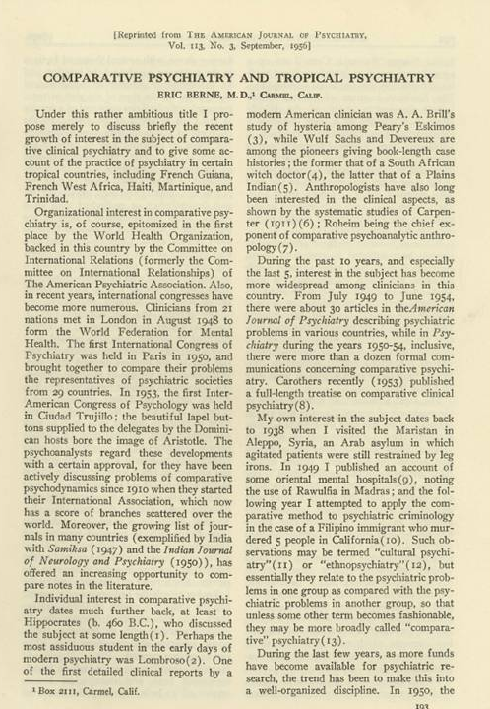
Comparative Psychiatry and Tropical Psychiatry, 1956
Notes:
1956: This is a paper in which he looks at comparative psychiatry in certain tropical countries: French New Guinea, French West Africa, Haiti, Martinique and Trinidad.

Slide 59
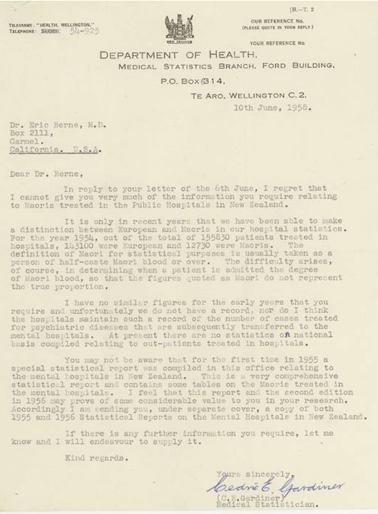
Letter from New Zealand, 1958
Notes:
1958: New Zealand

Slide 60
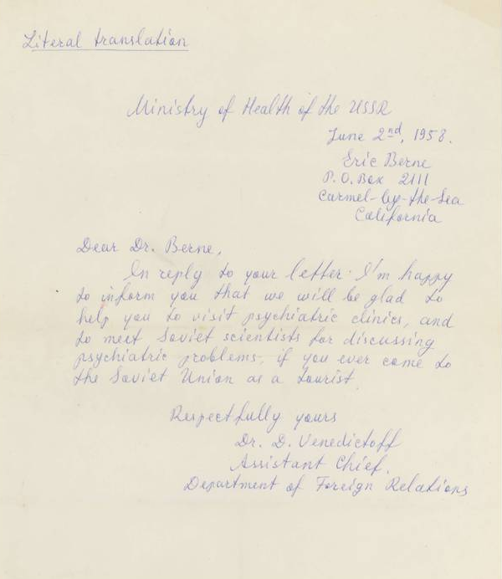
Letter from USSR, 1958
Notes:
This slide shows a letter from the Ministry of Health in the USSR telling him he can visit the Soviet Union and visit psychiatric clinics there. This is a hand-written, literal translation of the original letter.

Slide 61
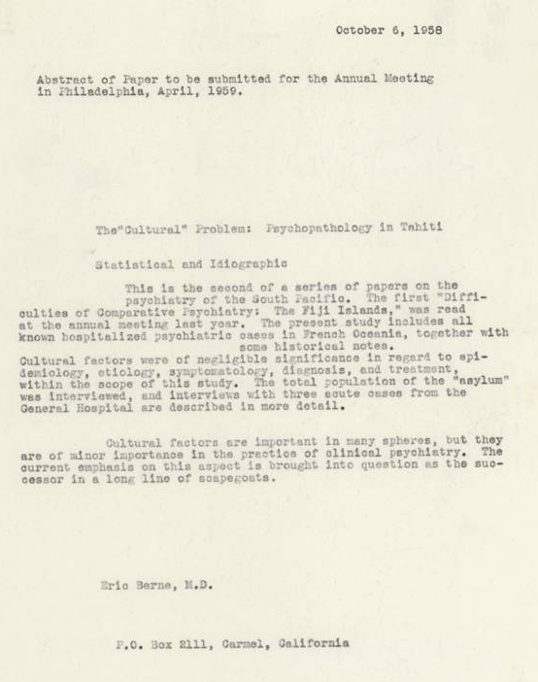
Psychopathology in Tahati, 1958
Notes:
The “Cultural” Problem: Psychopathology in Tahiti
Abstract of paper to be given at an Annual Meeting in Philadelphia but we don’t know which conference (It may have been American Psychiatric Association)

Slide 62
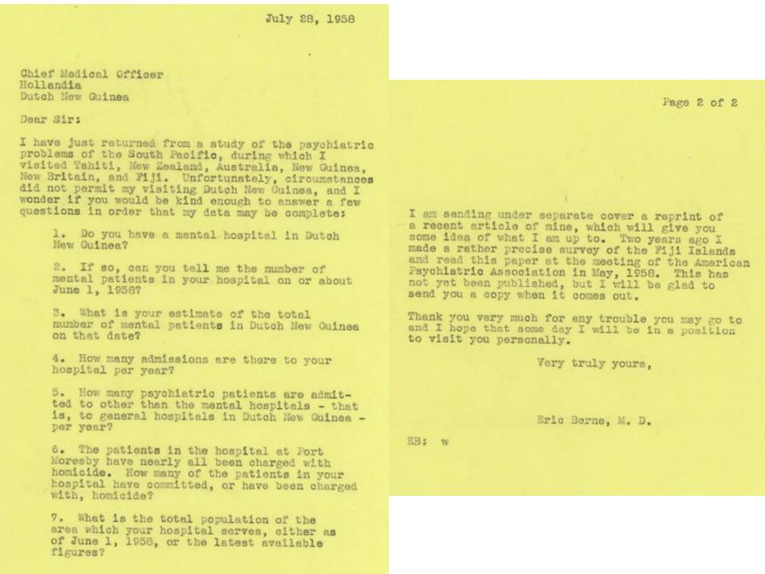
Letter to Dutch New Guinea, 1958
Notes:
1958 This is one of Eric’s letters written to the Chief Medical Officer in Dutch New Guinea asking for information to complete his data. He had already visited Tahiti, New Zealand, Austrailia, New Guinea, New Britain and Fiji.

Slide 63
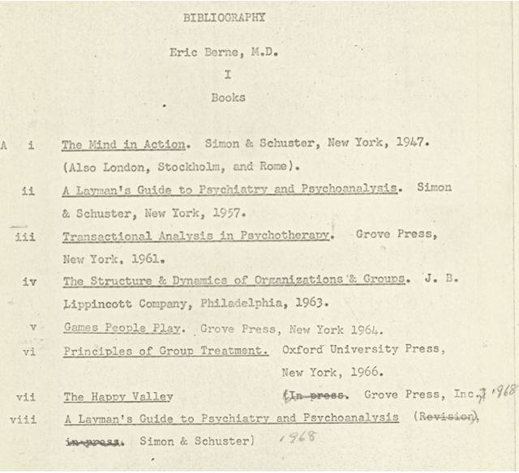
Bibliography Books
Notes:
This is a bibliography of books, and on following slides articles, through 1960.

Slide 64
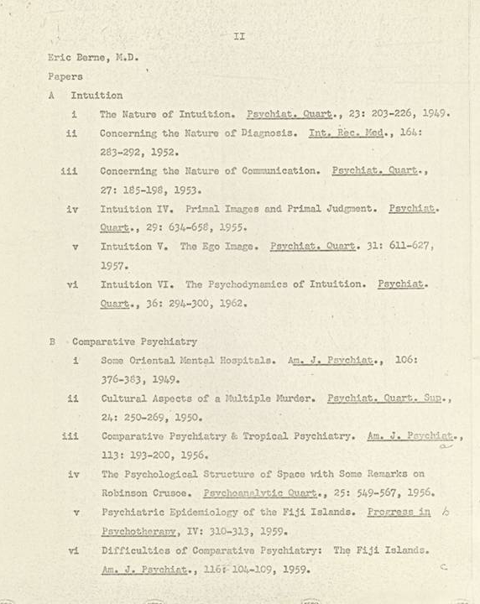
Bibliography through 1960
Notes:
Here is his bibliography that his secretary typed for him with all of his articles up until 1960. She had a more modern typewriter while he wrote on that old typewriter in his study for his entire life.

Slide 65
[]

Slide 66
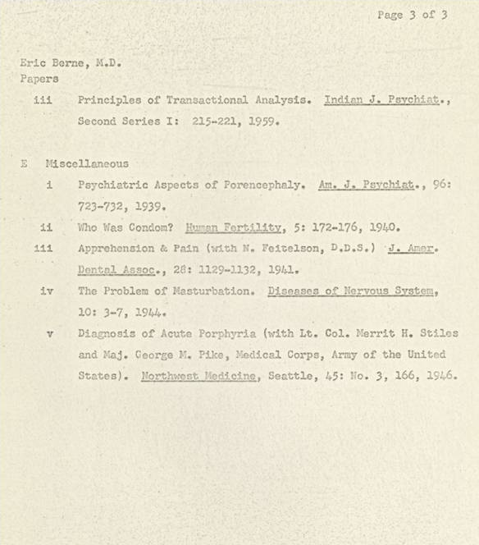
[]

Slide 67
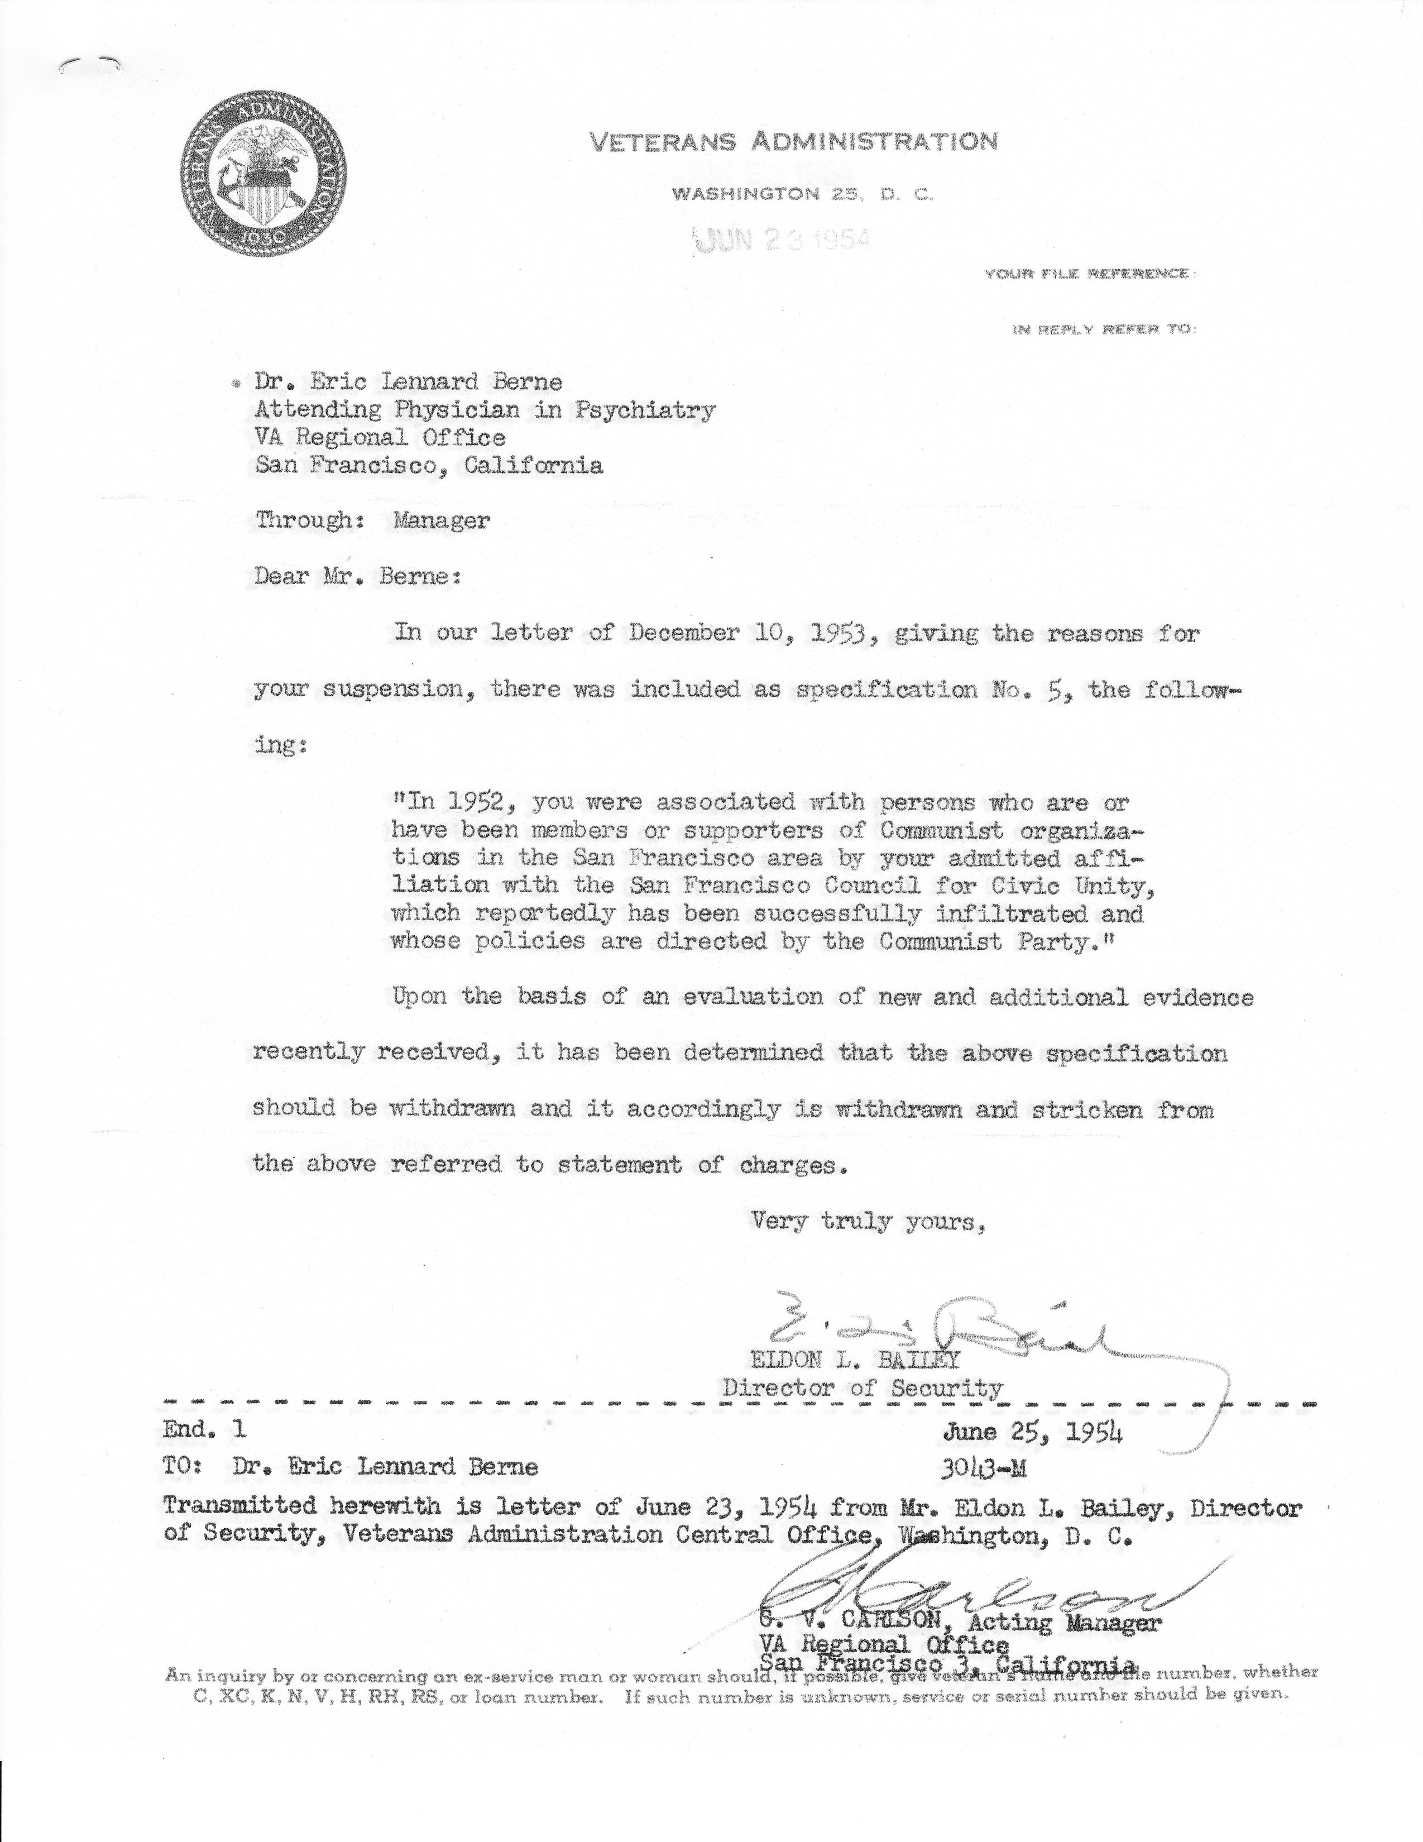
Veterans Administration Letter, 1954
Notes:
In 1954, when Eric was an Attending Physician in Psychiatry at the Veteran’s Administration Hospital in San Francisco he was suspended because they thought he had been involved in Communist activities. There followed an interview with the Veterans Administration and Eric was represented by an attorney from the American Civil Liberties Union. I read the 65 page transcript of the proceedings. The result was that he was cleared of any wrongdoing. He was not reinstated at the VA.

Slide 68
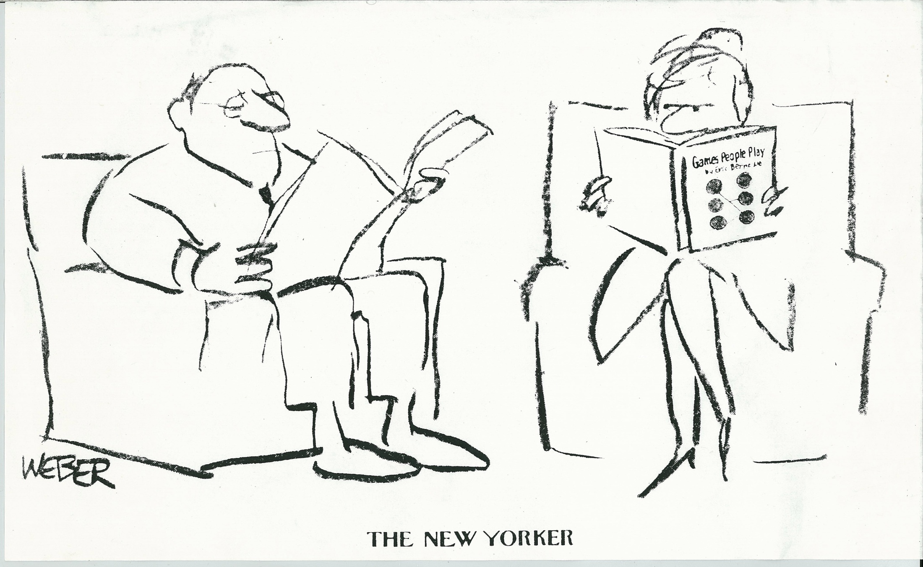
Cover: New Yorker Magazine
Notes:
Cover of The New Yorker, date unknown, when Games People Play was at the height of it’s popularity. Games People Play sold 3.5 million copies

Slide 69
www.EricBerneArchives.org
We Thank Our Donors
Allen Adler · Anonymous · William Cornell · Conchita De Diego · DGTA · John Dusay · EATA · Ecole d'Analyse Transactionnelle · Eric Berne Fund for the Future (ITAA) · Eric Berne Celebration Dinner · Ann Heathcote · Muriel James · Jessica Leong · Marco Mazzetti · ÖATA (Austrian TA Association) · Seven Italian TA Associations · Chie Shigeta · Carol Solomon · USATAA · Abe Wagner
Inger Acking · Jose Antonio Alonso · Fusun Akkoyan · James Allen · Asociacion Peruana de Analisis Transaccional · Alison Ayres · Ellyn Bader · Vicente Barreiro · Brenda Bary · John Baxendale · Joanna Beazley · Servaas Van Beekum · Terence Alan Berne · Annika Björk · Nicholas Berne Calcaterra in memory of Ellen Berne · Maritza Caloggero · Manuel Francisco Masso Cantarero · Karol Cavero · C.E.P Eric Berne · Centro de Psicoterapia Integrativa y Analisis Transaccional · Rosario Chavez · Christine Chevalier · Cinzia Chiesa · Jean I Clarke · Mary Cox · Delegates of Osaka Conference · Janice Dowson · Fanita English · Michele d'Errico · Richard Erskine · Antonella Fornaro · Rafaella Leone Guglielmotti · Bergitta Heiller · Marcia Herman · Barbara Hibner · Susana Ifland · ITACA · Instituto Mexicano de Análisis Transaccional · Vann Joines · Les Kadis · Taibi Kahler · Steven Karpman · Karol Kavero · Roland Johnsson · Leonard Lang · Pam Levin · Francesco Lonati · Ruth McClendon · Cathy McQuaid · Angela Melgar · Ellen Nathanson · Trudi Newton · Gloria Noriega · Steff Oates · Thomas Ohlsson · Jayne Owen · Arlene Pearl · Peter Pearson · Antonio Pedreira · Sonia Nugueira Pedreira · Jesus Cuadra Perez · Al Rabiei · Claudie Ramond · Clarissa Ruggieri · Celia Simpson · Jake Solomon · Margarita Soltero · Hilary Spenceley · Claude Steiner · Thomas Steinert · Students at Instituto Mexicano de Analisis Transaccional · Karen Swander · TA Association of Scotland · Jose Antonio Chumillas Talavera · Henk Tigchekaar · Anne Timpson · Lisa Topliss · Reiko True · UNAT-Brasil · Pablo A Yague Valentin · Alejandro Velez · Florence Van Loon · Jonathan B. Weiss · Laurie Weiss · Xinergia · Jeff Zeig
Notes:
This is our project: The Eric Berne Archives. We want publically to thank all of our donors. We have now begun the project at the University of California and by the time of the TA World Conference in San Francisco in 2014, a “sizable and comprehensive collection” of Eric Berne’s archival material will become available to all of you online, forever and for free.

Slide 70
Your donation welcome!
Please become one of our supporters and donate to the Eric Berne Archive Fund at
EricBerneArchives.org
Every donation will serve to increase the size of the Eric Berne Collection at the University of California in SF. We welcome your participation and we are grateful for your help!
Notes:
This slide presentation was compiled by Carol Solomon who, with a group of colleagues, is raising funds for the completion of the Eric Berne Archives. You can contact her directly at solomon.phd@gmail.com
You may also contact other members of the Archive Team:
Ann Heathcote, UK ann.heathcote@btinternet.com
Marco Mazzetti, Italy marcom.imat@gmail.com
Gloria Noriega, Mexico gnoriega@imat.com.mx

